Slide 1
Why did the universe cool as it expanded?
Entropy
Lecture 2 following the writings of RJP Williams

Slide 2
This lecture has all three laws of thermo
Chapter 1 = heats of reaction (1st law)
Chapter 2 = entropy (2nd law) and the 3rd law
Your questions can form bridges between the laws and the book

Slide 3
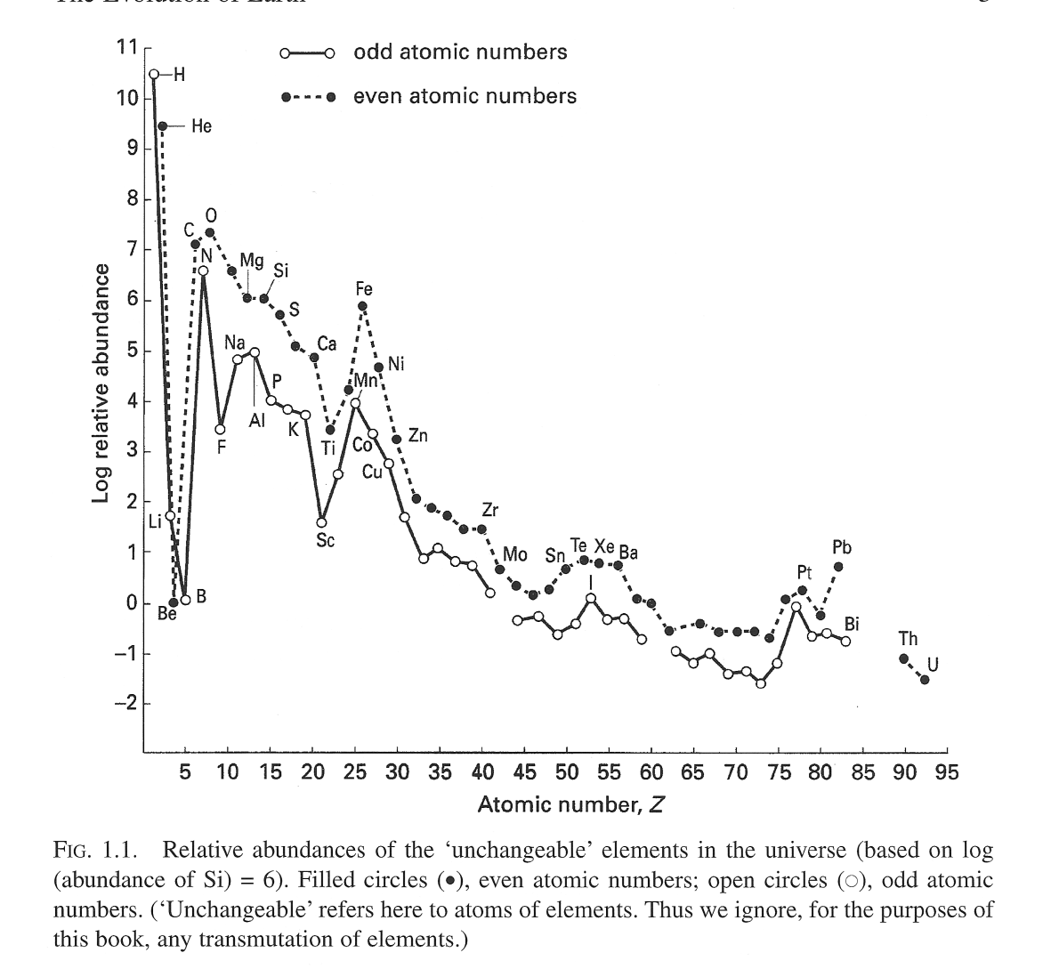
Over time, the universe changed from hydrogen to this:
These abundances depend on the equations that govern the interactions of protons with neutrons (the strong nuclear force).
Notice that even numbers of protons are more stable than odd.
These are “frozen” on the time scales of most chemical processes.
Fig. 1.1 TCoE p. 3 Relative abundances of unchangeable elements in the universe.

Slide 4
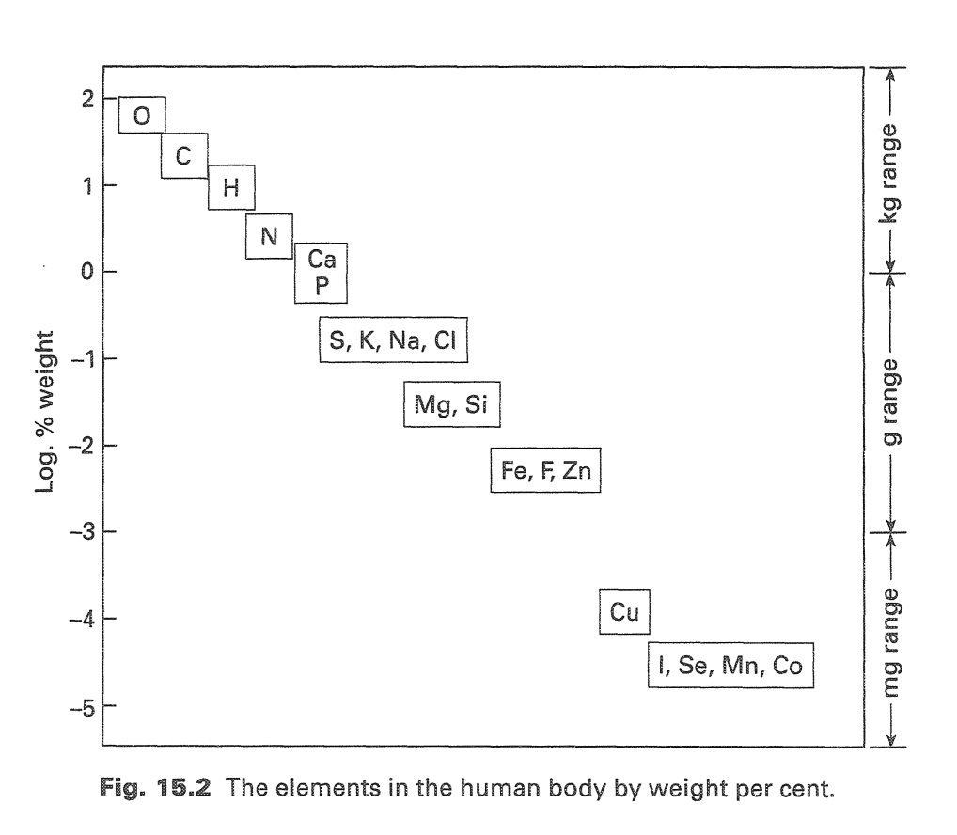

The human body uses what’s available from the universe

Slide 5
These elements are arranged in the periodic table
The table was put together based on Mendeleev’s insights about how some elements were similar to others
Can a computer recreate the table with a “blind” process, just from elemental properties?

Slide 7
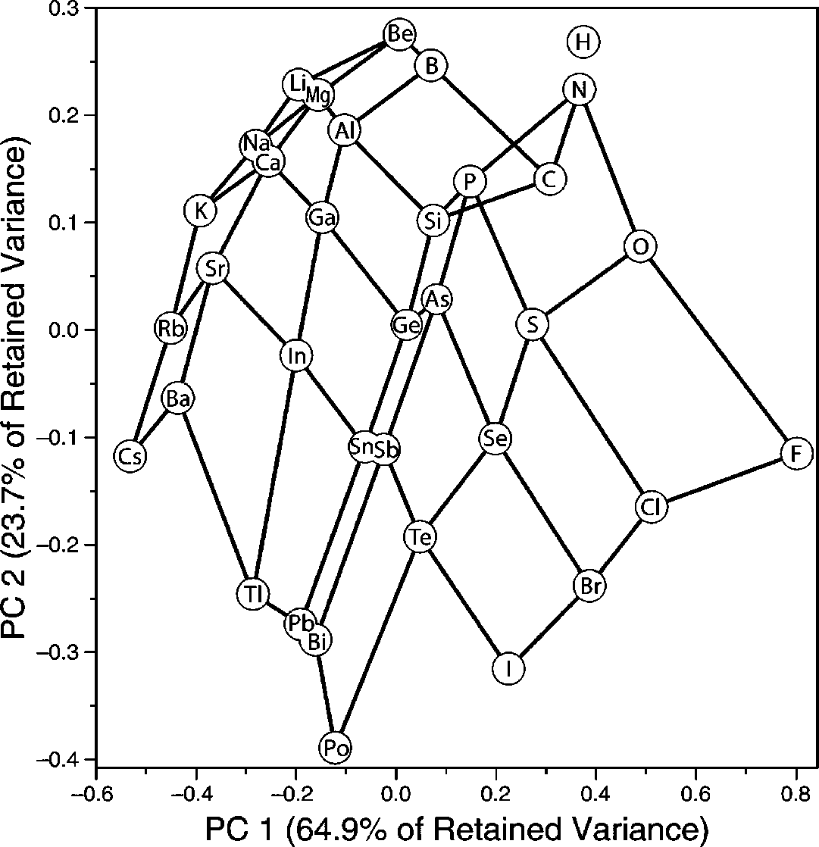
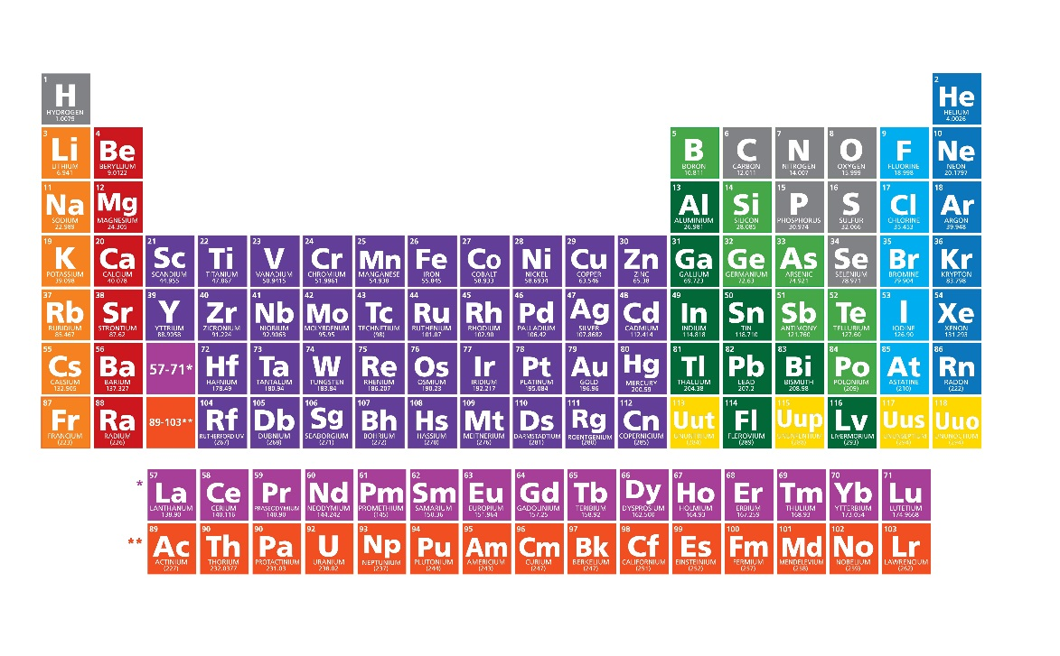
The computer calculates a tilted periodic table!

Slide 8
Binding properties follow periodic trends

Slide 9
Bond lengths:
Ni < Co < Fe < Mn < Mg < Zn

Slide 10
Binding strength (P50):
Ni > Co > Fe > Mg > Mn > Zn

Slide 11
Heats of adsorption (-Qst):
Ni > Co > Fe > Mg > Mn > Zn

Slide 12
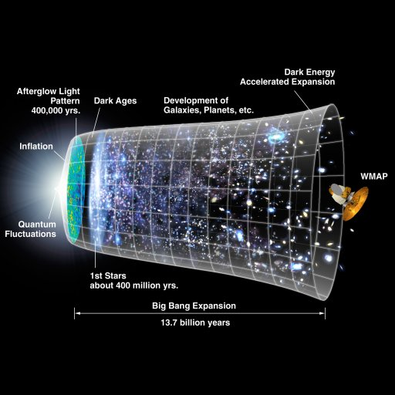
In the beginning
... There was light
And the light condensed into atoms
And the atoms clumped together and cooled down
Why would they do that, given the second law of thermodynamics?

Slide 13
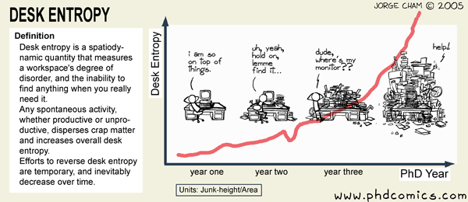

Slide 14
But entropy ~ spreading out!
Entropy can decrease in the system if it increases in the surroundings
This paper provides a good example of how this can happen in processes like crystallization:
But if by “surroundings” we mean the rest of the universe… how do we solve this problem if there can be no energy transfer outside the universe?!

Slide 15
Thanks to the consistency of the laws of thermodynamics, we can recreate the sequence of creation
(and you can follow some of it after two chapters of P-chem)

Slide 16
What is the entropy change of an exploding universe?
Spatial entropy
Think of probabilities: for this example the probability of finding two particles on one side is 2/6, but of finding two particles on different sides is 4/6.
So the particles are 2X more likely to be spread out.
The mathematical probability of an arrangement is a measure of entropy
Or, in an equation: S = k Ω
  (constant) X (number of microstates available)
  Note: microstates can be thermal as well as spatial!
    Section 3.2.4 NSoCE

Slide 17
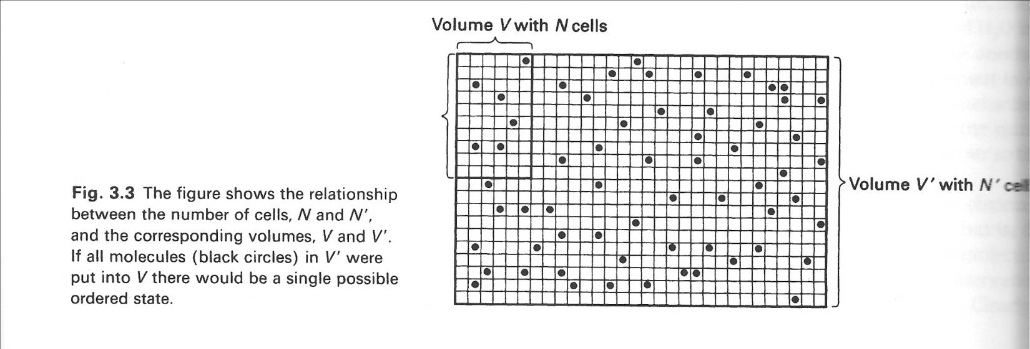
So why does the matter cool? Where does the energy go?
It goes into dispersion (configurational entropy).
There are more ways to arrange a bigger matrix than a smaller one.
So a bigger matrix, with more places for things to be, has more configurational entropy.
Or, in an equation, ∆S(conf) = R ln (Vf/Vi)

Slide 18
What about the entropy of random motion?
This is thermal (or, heat) entropy
The molecules can vibrate, rotate, or move electrons up and down, while staying in one place.
The question is, how many “thermal microstates” are accessible?
The result is, for thermal S, ∆S(therm) = C ln (Tf/Ti)
  (C is plain ol’ heat capacity)
Deep down, thermal and configurational entropy are the SAME THING
  (with different proportionality constants)

Slide 19
CONFIGURATIONAL THERMAL

Slide 21
In general, it takes more joules to heat bigger atoms to the same temperature, which makes sense if T=KE
Diamond (1)
  stiff, small = low Cp,m
  Compare to graphite
Copper (14)
  medium
Lead (38)
  loose, big = big Cp,m

Slide 23

Everything in the universe … including the universe … cools as it expands
For an ideal gas expanding:
  S(system) = S(conf) + S(therm) = RT ln Ω
Remember that ∆S = q/T
  If the system is closed and isolated, no heat can be transferred out of the system (there IS no outside), so that heat is zero!
  The microstates have increased but there’s no place for heat to move to!
  When a gas expands, S(conf) increases, and if it’s isolated S (therm) must decrease to keep S(system) constant
The universe is pretty isolated itself (in that it has NO surroundings to exchange heat with)
So, like an ideal gas, the thermal entropy of the atoms moving randomly is turned into configurational entropy of stuff distributed randomly, and everything cools down
But … what about the Second Law??

Slide 24
Our universe is so BIG that things can cool (and form order) while entropy increases
  Ok, ok, ∆S(universe) > 0 … but other things can be >> 0
  Another way to look at it:
If your system is the universe, S(universe) = S(conf) + S(therm)
If ∆S(universe) > 0, then ∆S(conf) just has to be bigger than it, and ∆S(therm) < 0.
So it helps to have ∆S(conf) be really huge! A huge universe makes sense under this argument.

Slide 25
Because ANYTHING cools when it expands, entropy caused the formation of stars and the earth
“The cooling of the universe due to expansion was and is today one major cause of the natural selection of the chemical elements into their observed physical conditions.” (NSoCE p. 92-93)
This cooling from expansion was counterbalanced with heat from the radioactive decay of heavy elements in the earth’s core!
For instance, as the earth cooled to 300K water could form on its surface:
“The natural selection of the chemical elements decided that the only liquid on the Earth’s surface some 4-5 X 10⁹ years ago was water. If the temperature had fallen lower, to around -90°C, and CO2 has been the only gas available, solid carbon dioxide would have formed, a very real possibility observed on other planets, for example on Venus and Mars at the polar caps.” (NSoCE chapter 3)

Slide 26
Bring 2 questions on Monday (written)
Preferably one for discussion (no answer necessary), and one for homework (with answer)
  Involving the topics from the first three chapters of AWfD
  Possibly using data or concepts from today?
We will discuss what you wrote in the first half-hour of class

