Slide 1
Living, fast and slow
Data Talk for Kinetics Chapters and A World from Dust Chapters 10-12

Slide 2
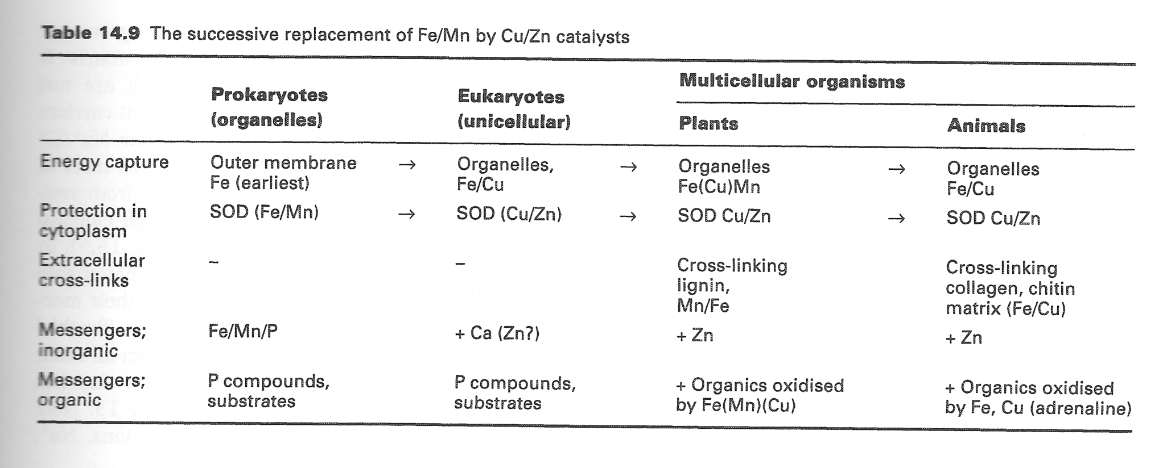
The new multicellular organisms use Cu and Zn
Zn and Cu seem to always be used for “advanced purposes”

Slide 3

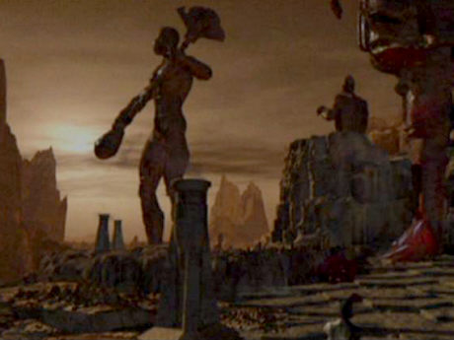
Some crustaceans have blue blood (do Vulcans have green?)
This is because they have Cu-based hemocyanin rather than Fe-based hemoglobin
Hemocyanin works well in cold environments with low O₂
Mr. Spock’s blood is green because Vulcans have copper blood.
Comment on the prospect of copper-based blood coming from a desert planet like Vulcan

Slide 4
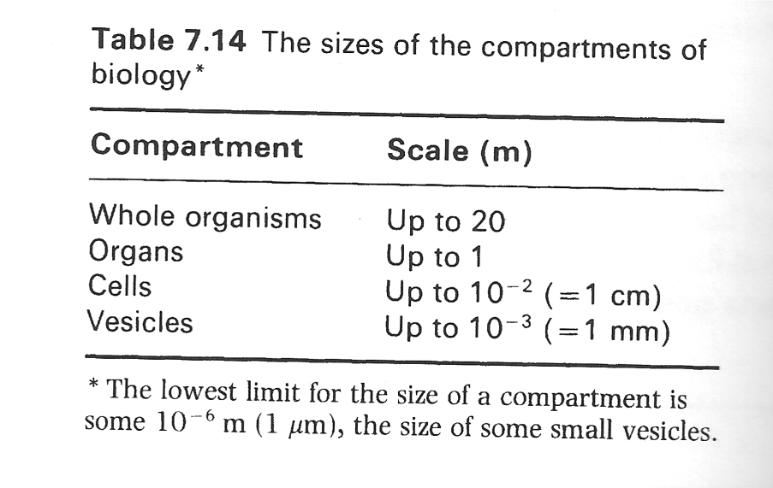
The stage is set for organs to form
Oxygen allowed cells to form cross-linked walls and connections
Zn allowed cells to cut those connections loose when necessary
Cu allowed brand-new kinds of oxygen chemistry
Different compartments, large and small, can hold different chemicals

Slide 5
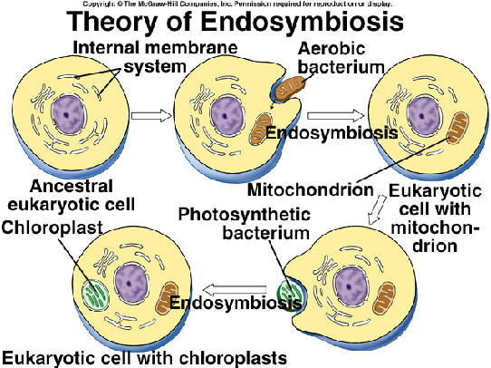
The first organs?

Slide 6
The first “organs” = subcellular structures
Mitochondria make ATP by turning acetyl-CoA and O₂ into water and CO₂
Chloroplasts do the reverse chemistry for photosynthesizing plants
Both of these have their own (circular!) DNA like a bacterium, their own membrane (with bacterial lipids), they reproduce asexually when the cell divides, etc.
Some bacteria can “eat” (phagocytose) each other; maybe one stuck around and specialized?

Slide 7
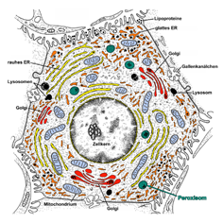
Interesting note: the inside of cells is still reducing
The cytoplasm is still reducing, and seems to echo the conditions of the early earth
Oxidizing chemistry is done in separate compartments called peroxisomes
“The major necessary strategy of eukaryotes to reconcile a reductive cell’s cytoplasm with an oxidizing environment was the development of new membranes and compartments separated from the cytoplasm inside cells and where oxidizing chemistry could take place.”
  ARTICLE p. 467

Slide 8
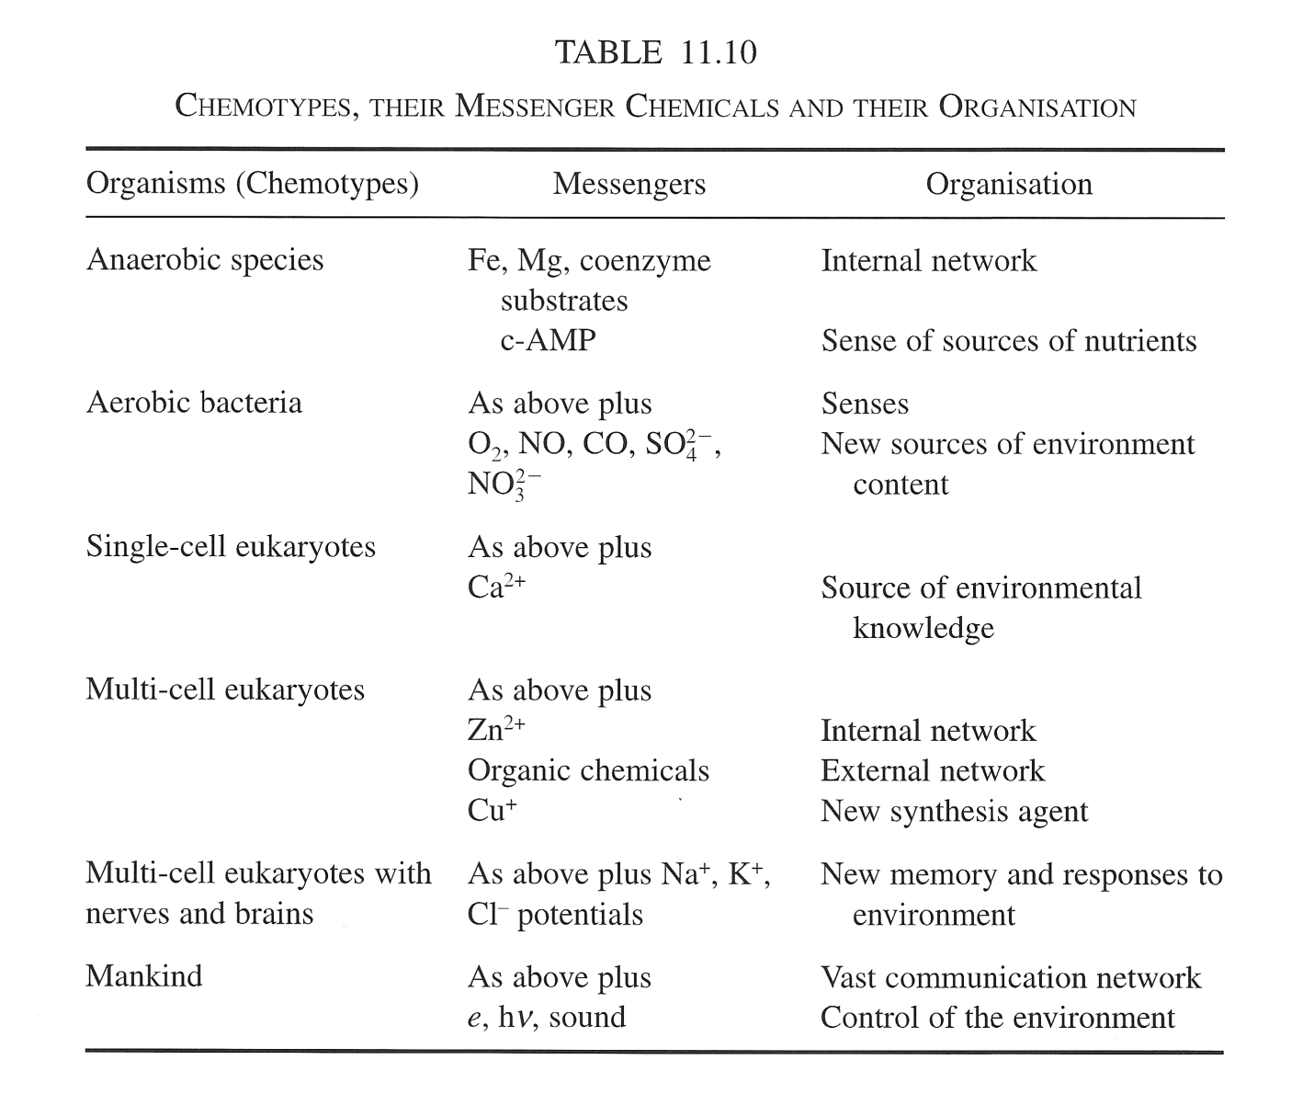
Different compartments need to communicate

Slide 9
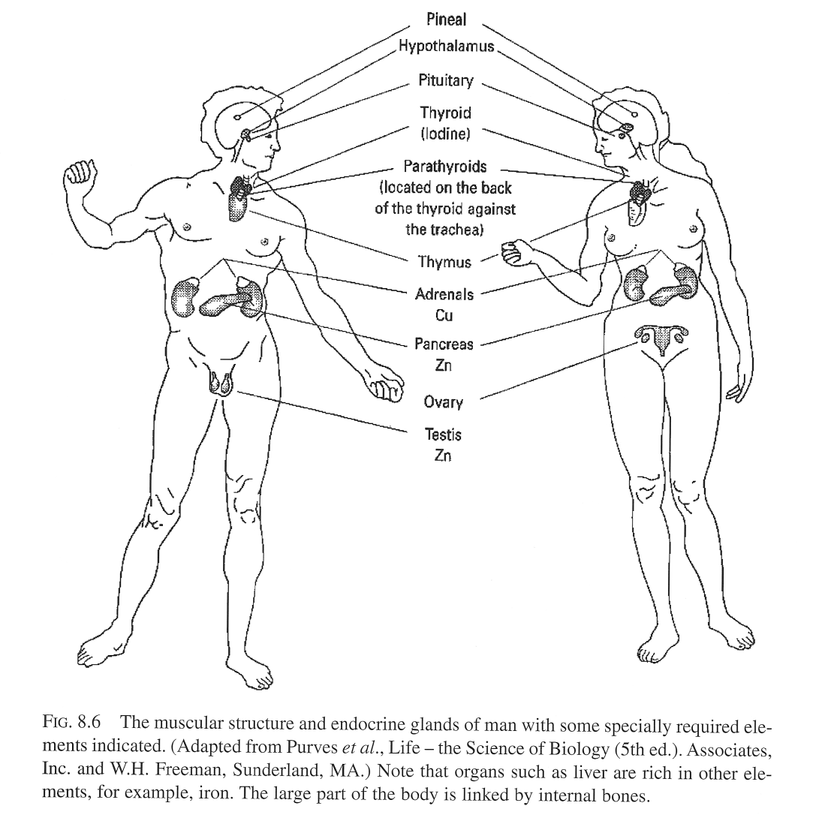
Organs are distributed compartments that require specialized communication: hormones

Slide 10
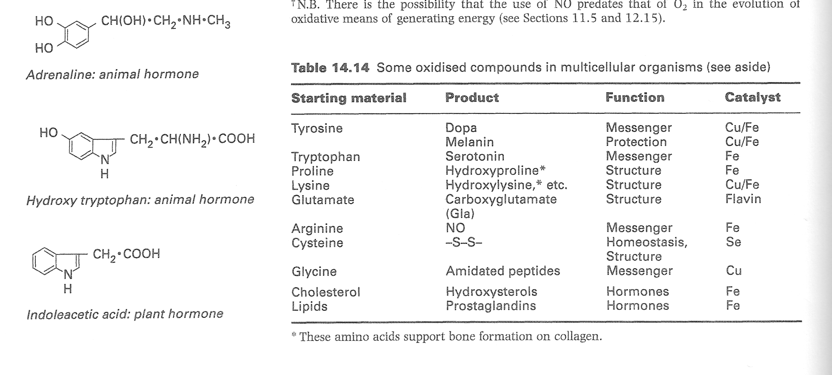
Hormones communicate between organs: many are amino acids that were oxygenated by Cu or Fe

Slide 11
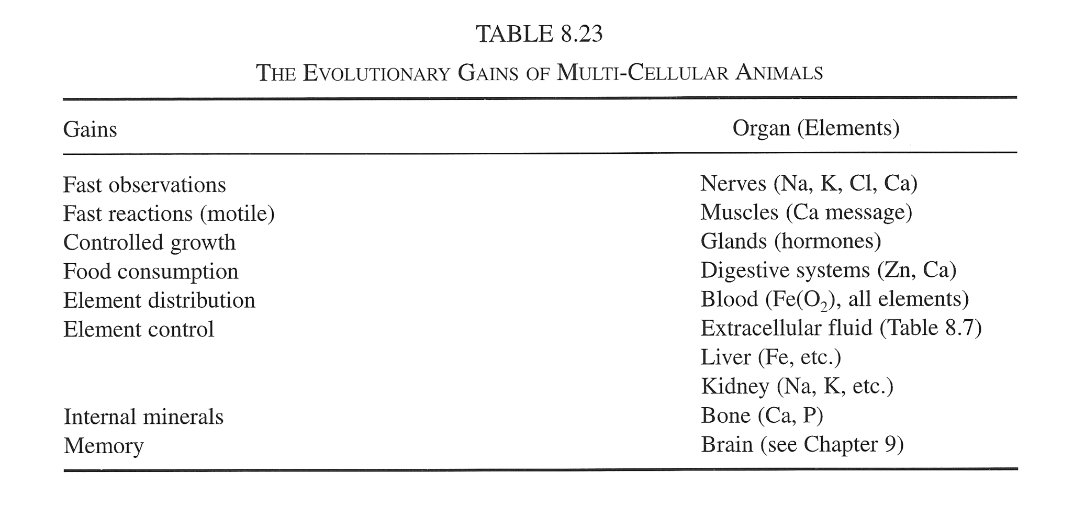
Organs specialize in different functions (and elements!)

Slide 12
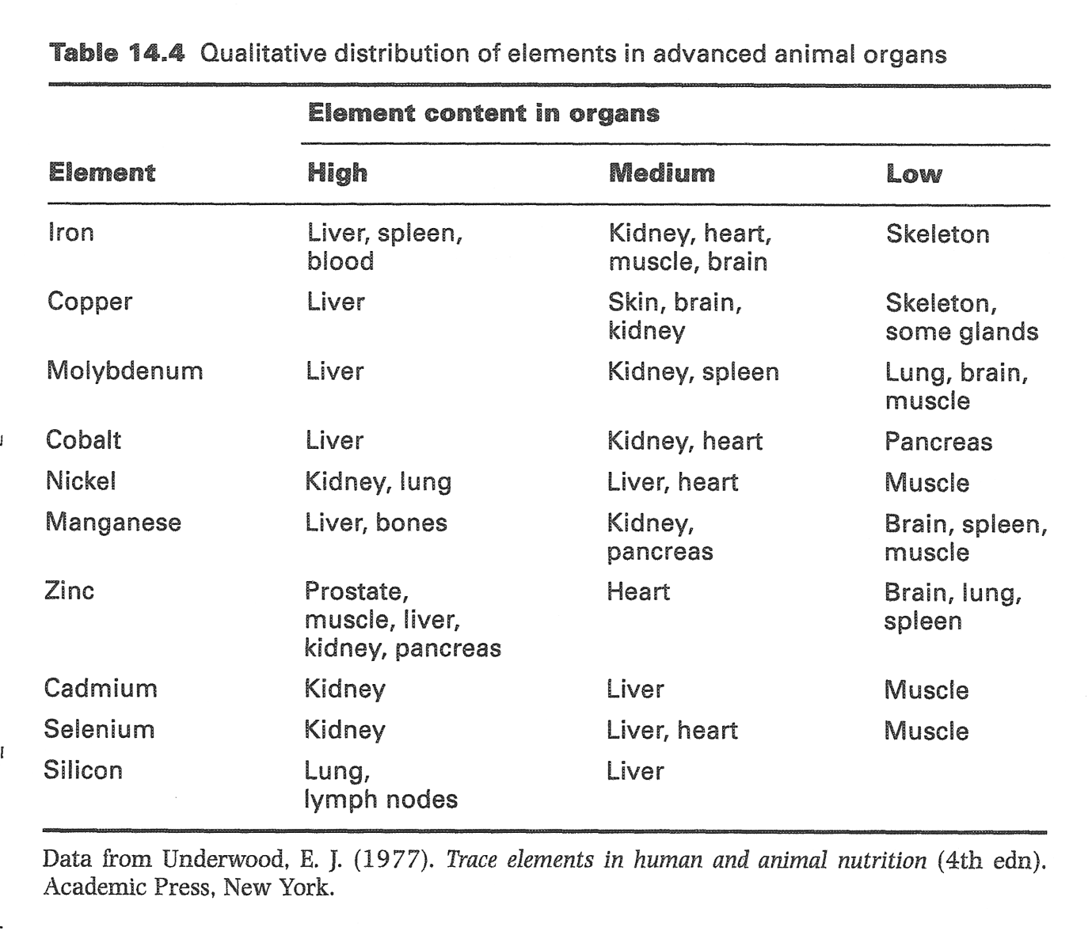
You can also organize it by element

Slide 13
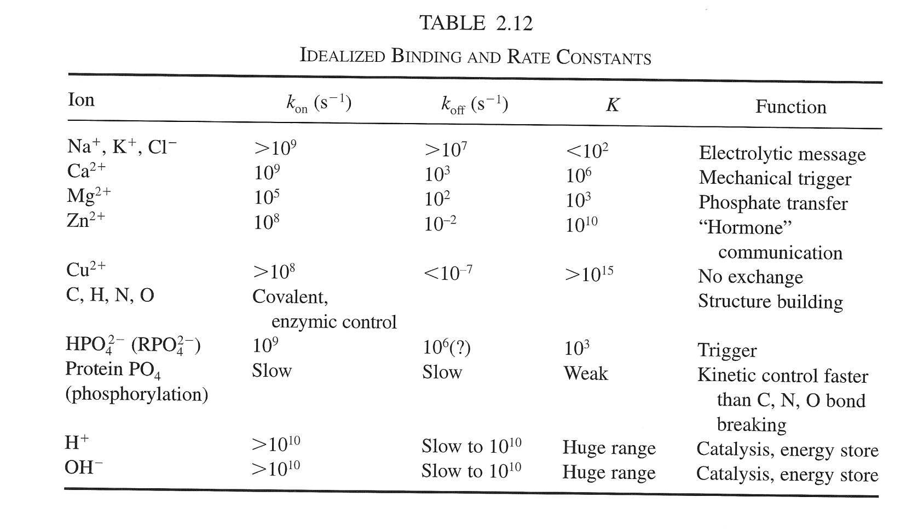
Why do organs pick certain elements?
Part of the answer is KINETICS
Fast on, fast off
Fast on, slow off
Slow on, slow off
Fast on, very slow off
Never off!

Slide 15
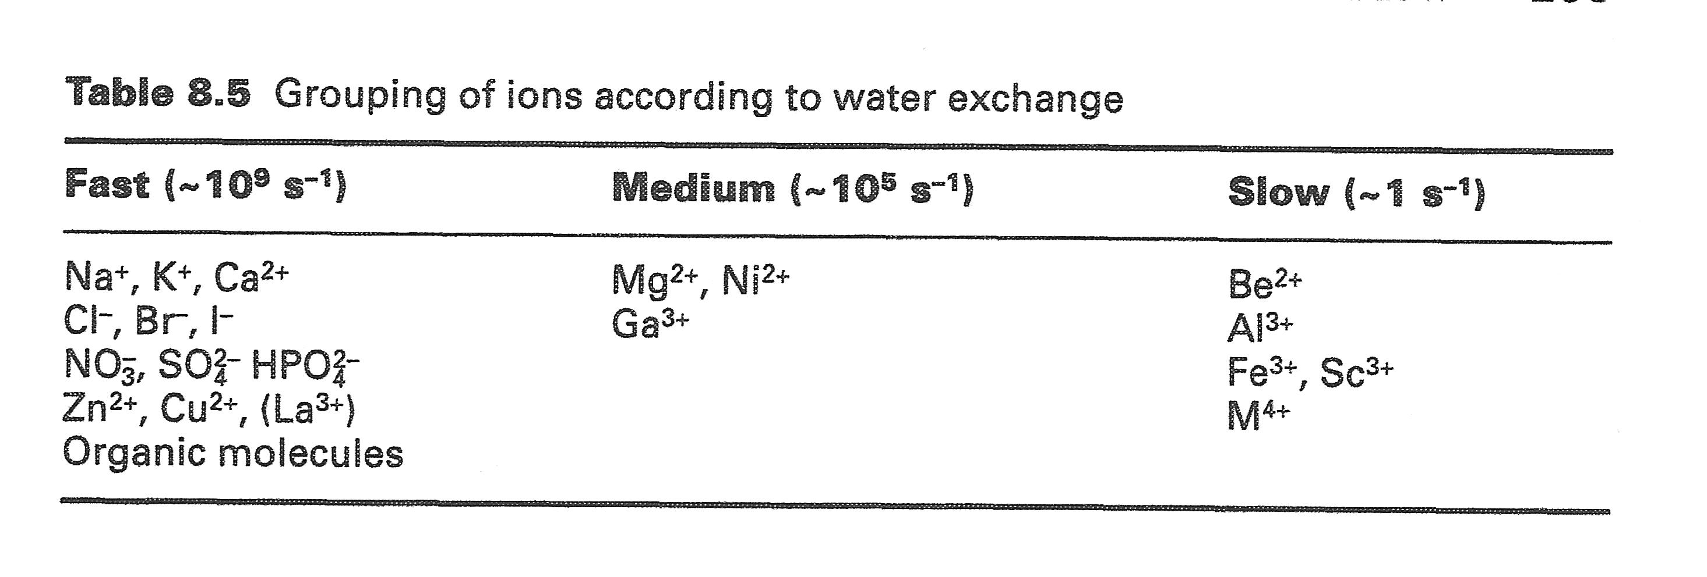
These numbers are different because some ions hold onto water longer than others

Slide 16
The brain is a highly specialized organ
Animals need fast nerves to respond quickly to the environment
  Fast muscles require fast nerves!
Fast nerves run on fast-binding, fast-dissociating ions Na⁺, K⁺, Cl⁻ and the fast-on, slower-off Ca²⁺.
Before brains, information was stored in DNA, a covalently-bound polymer of 4 bases.
In brains, info is stored in the form of ~20 different ions and neurotransmitters in gradients of concentration, a more tunable and faster-responding system.
  (ARTICLE p. 474)

Slide 17
Show animation of nerve cell
http://www.spu.edu/depts/its/neural_transmission.html
Note calcium at the end, with its special kinetics

Slide 18
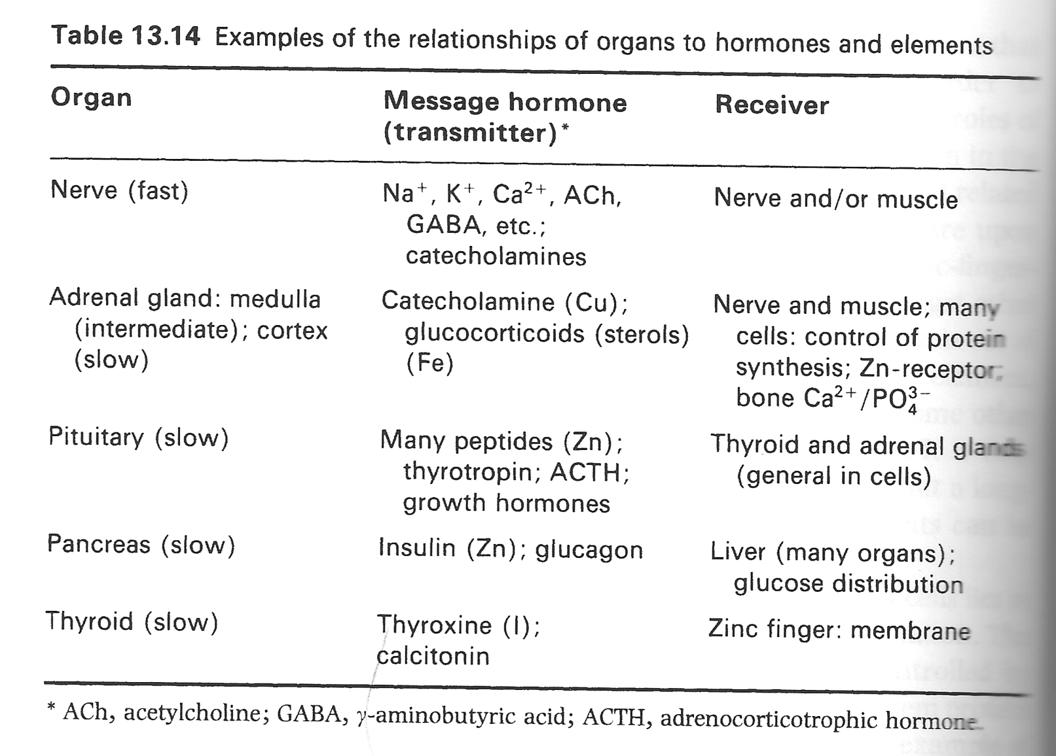
Slow organs get slow-exchanging elements

Slide 19
Kinetics can be used to explain why Pepto-Bismol kills bacteria but not you

Slide 20
Recall how glutathione’s sulfurs help clean up heavy metals

Slide 21
3 pathways protect your cells from bismuth
#1
#2 & 3

Slide 22
Point #1 is explained with kinetic equations you can understand now

Slide 23
The math makes a hyperbola showing why smaller cells absorb more bismuth

Slide 24
Now it’s your turn
Pick an element and give a 12-minute presentation on its role in natural history (and history) on 6/3
  Start with the index
  Mention past uses in geology, chemistry, and biology
  Use its chemical “personality” from Data Talk 7-9, for example
  Look up at least two papers about that element’s role from the primary literature and tell us their titles
    Relate these to P-Chem topics like in the Data Talks
    Tell us about present and future uses of the elements

