Slide 1
How does energy move through the environment and life?
Data Lecture for A World from Dust Chapters 4-6

Slide 2
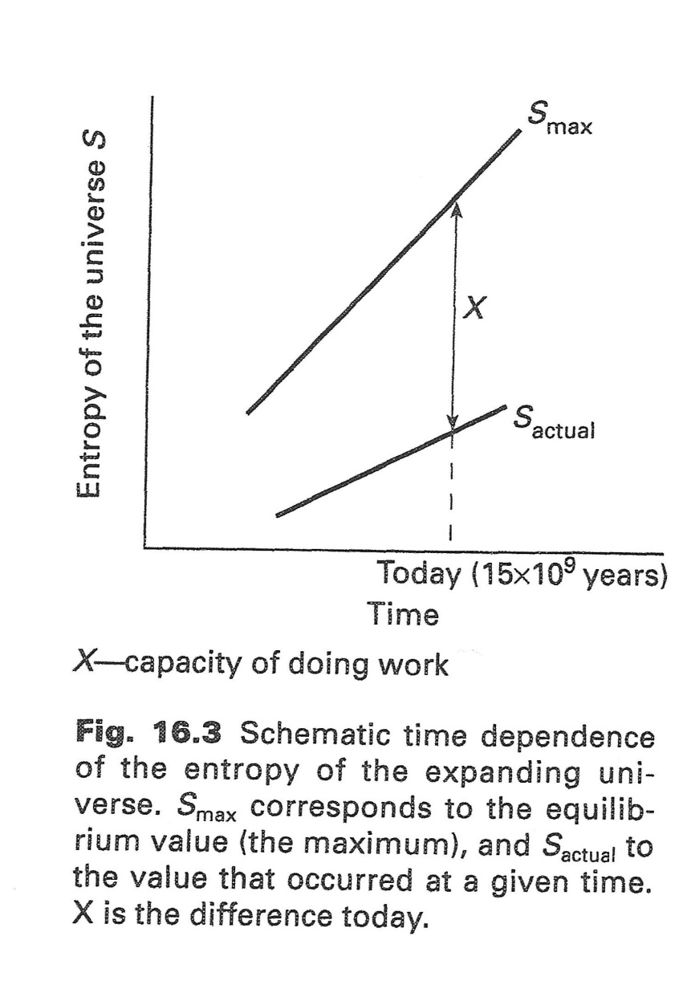
The Second Law says both of these slopes are positive:
Any system that has not been maximized in entropy allows us to do work
Note that you can only do work by increasing the entropy of the universe!
  Fig 16.3 BCtL p. 492

Slide 3
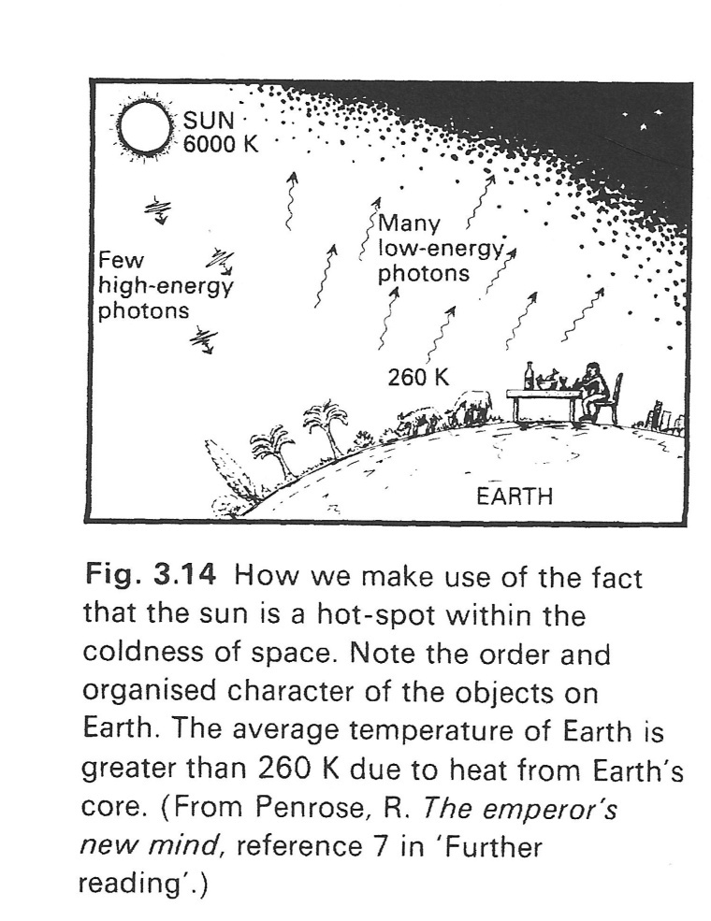
The bulk of the earth generates entropy by heat radiation
Light from the sun (few large quanta) → heat (lots of small quanta, DISPERSED!)
This is such a huge effect that local order is relatively minor, and entropy increases (and work is done) despite organization.
The tendency of the universe to increase entropy is fulfilled when an organized structure releases heat.
    NSoCE p.112.

Slide 4
A multi-layered device can take advantage of the spreading out of energy

Slide 5
Infrared antennae could capture this heat

Slide 6
A heat engine intercepts movement from hold to cold to do work (e.g., by turning a dynamo); An infrared rectenna uses it to move electrons

Slide 7
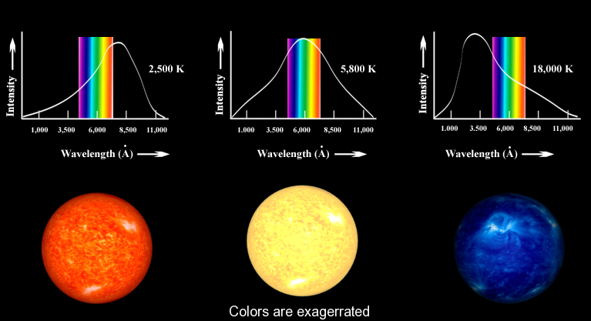
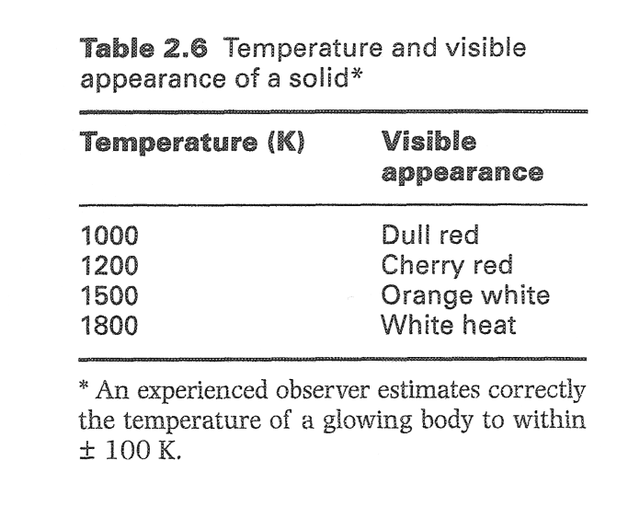
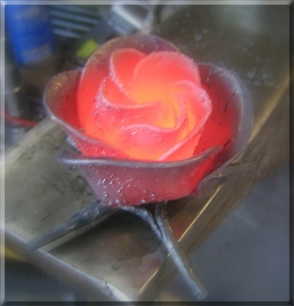
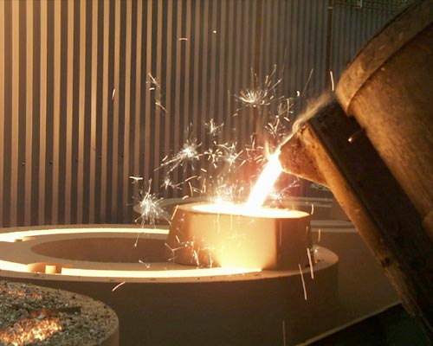
Hot stuff gives off light:
Star colors come directly from their temps
http://docs.kde.org/stable/en/kdeedu/kstars/star_colors.png

Slide 8
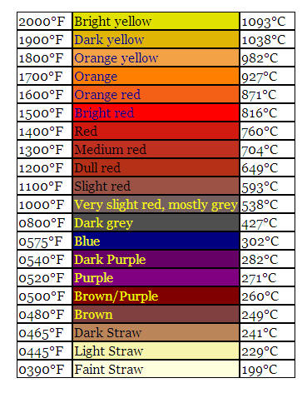
Whether hydrogen or iron, hot stuff glows the same color
You can tell the temperature of an iron pan from its color:
http://www.outdoorstirfry.com/images/Recipes/IronColor.jpg

Slide 9
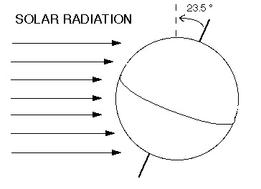
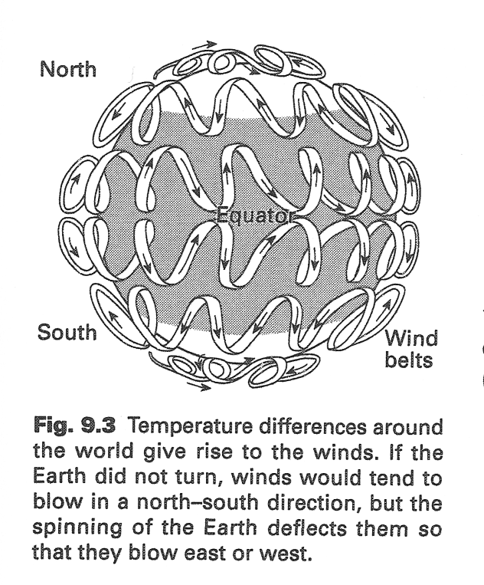
Two things heat the earth: its own core and the sun
The sun = 50-60K added to surface temp
Radioactive decay = 40K added to surface temp
The rest comes from the core’s own heat
The fact that the earth is tilted causes uneven heating between north and south, which results in west-east winds like the Jet Stream

Slide 10
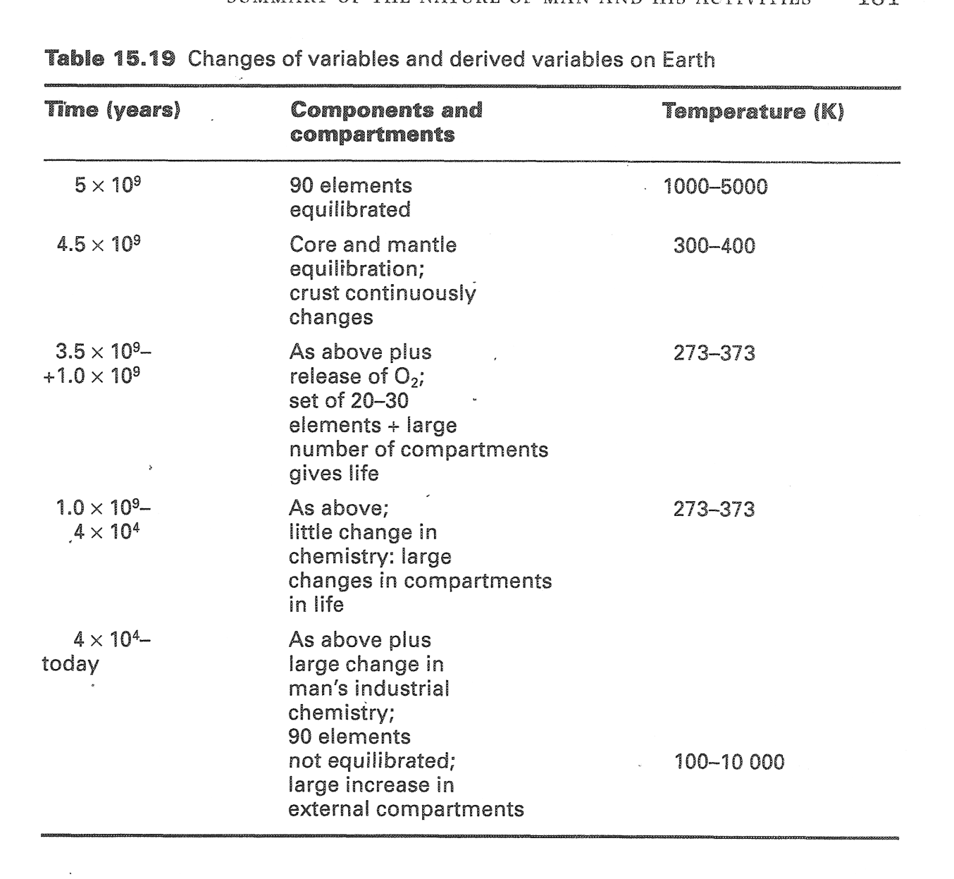
Note the temperature column: nearly constant!
2010 ref: even in this period oceans may have been <40°C!
Also note that these are ALL accessible temps anywhere on the crust (including deep sea vents or, in the last case, in laboratories)
Vol 464| 15 April 2010| doi:10.1038/nature08952

Slide 11
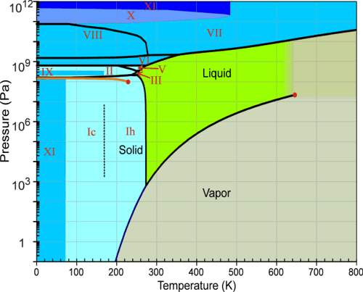
The early earth’s conditions moved directly toward what special point?
Water is “constrained” to be liquid at STP

Slide 12
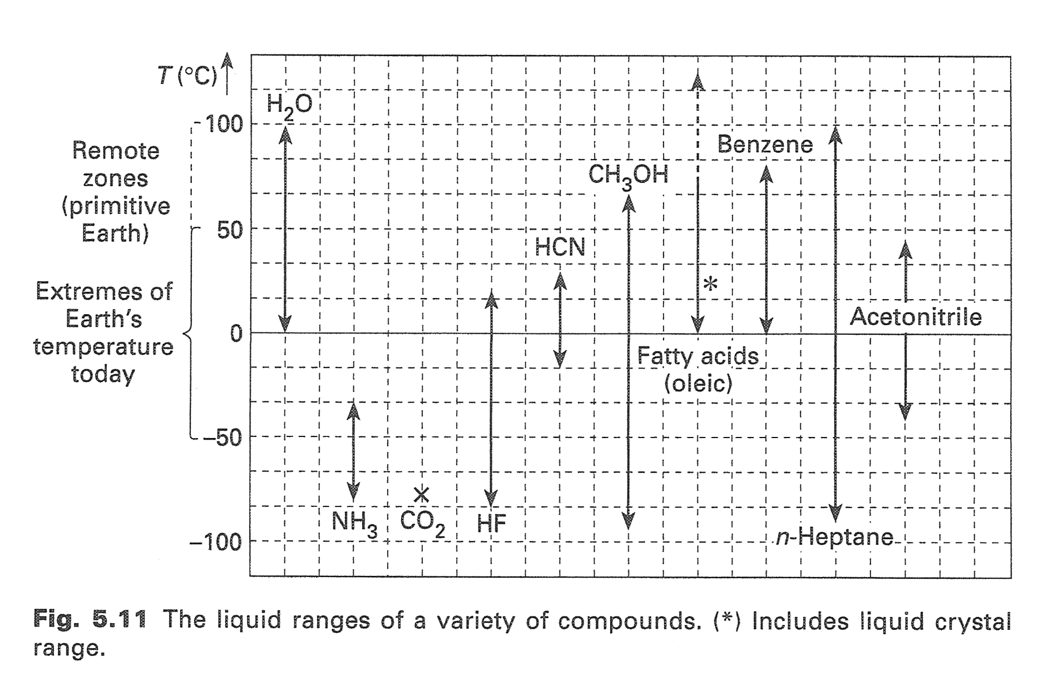
Most other simple/abundant molecules are not liquid in the earth’s temperature range
200°C
Water is special (and it has H-bonds too)
Formamide

Slide 13
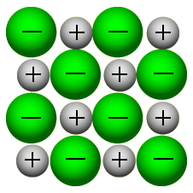
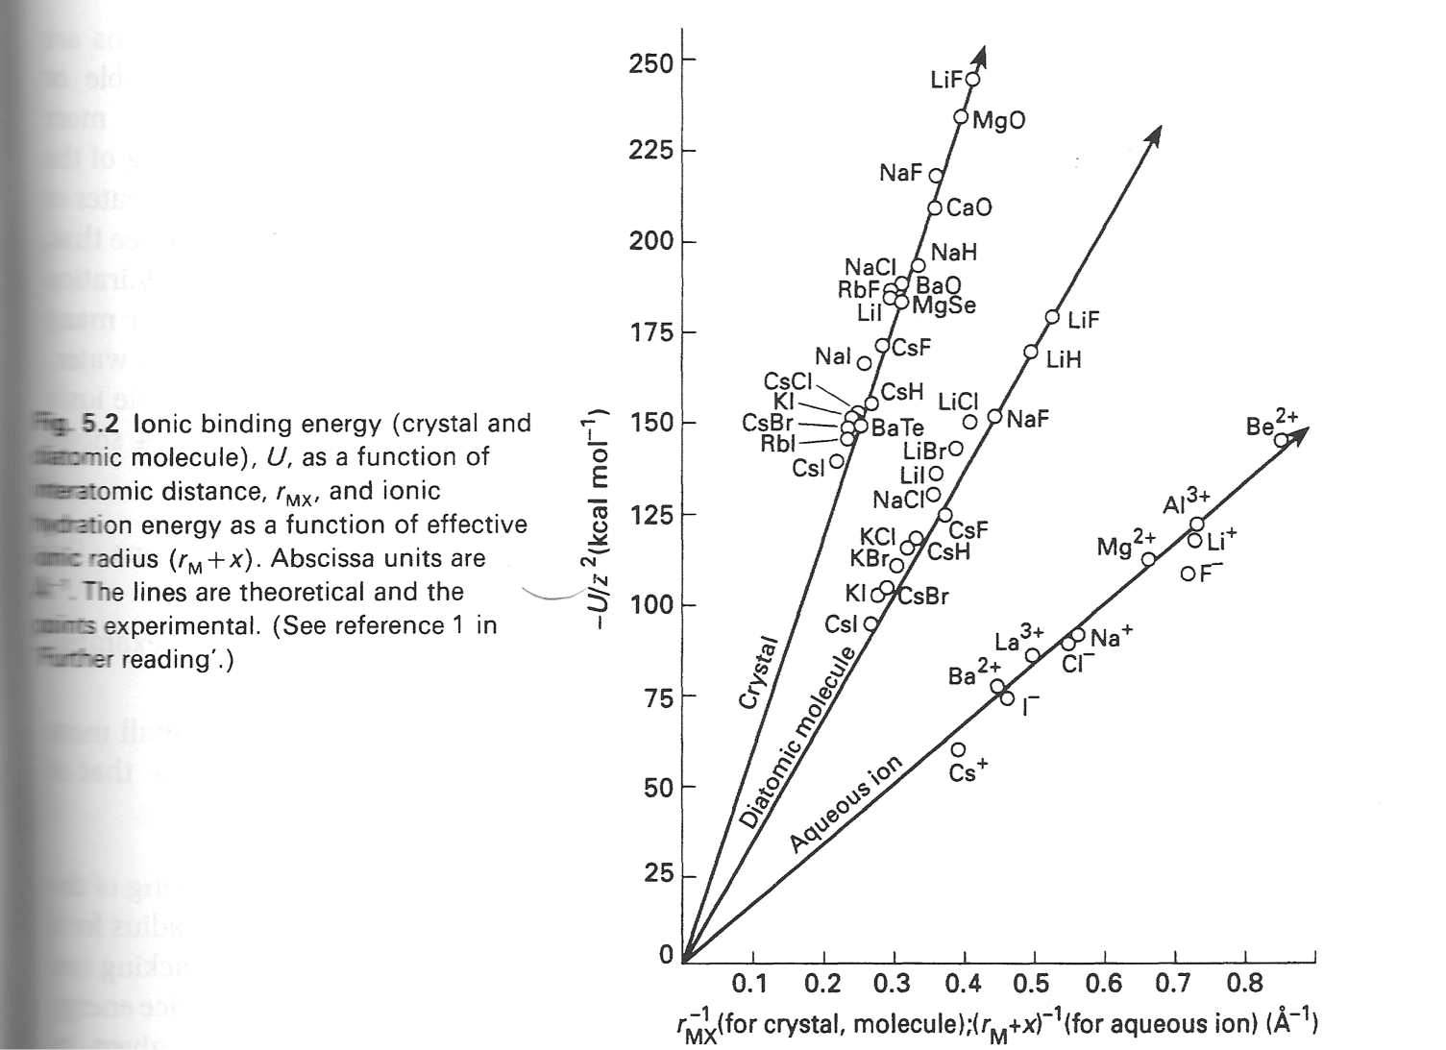
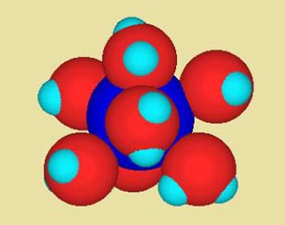
How will ions behave in the oceans? Ion pairs form lattices with ΔH_{f} 1.5 times the ΔH_{f} of pairing up (in gas)
This lattice cooperativity is why things will precipitate out of solution
Notice how it only depends on the radii of the charges
  It only matters how BIG the ions in the lattice are (and what their charges are)

Slide 14
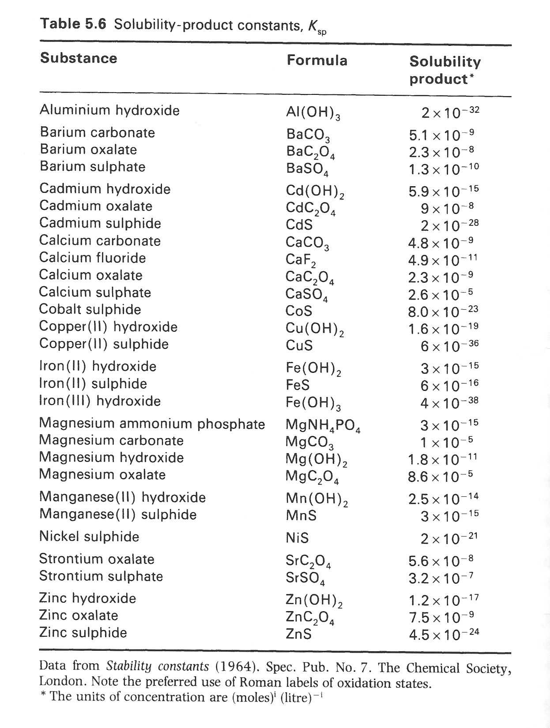
Want to know solubility? Measure a K_{sp}
K for this reaction:
precipitate → ions

Slide 15
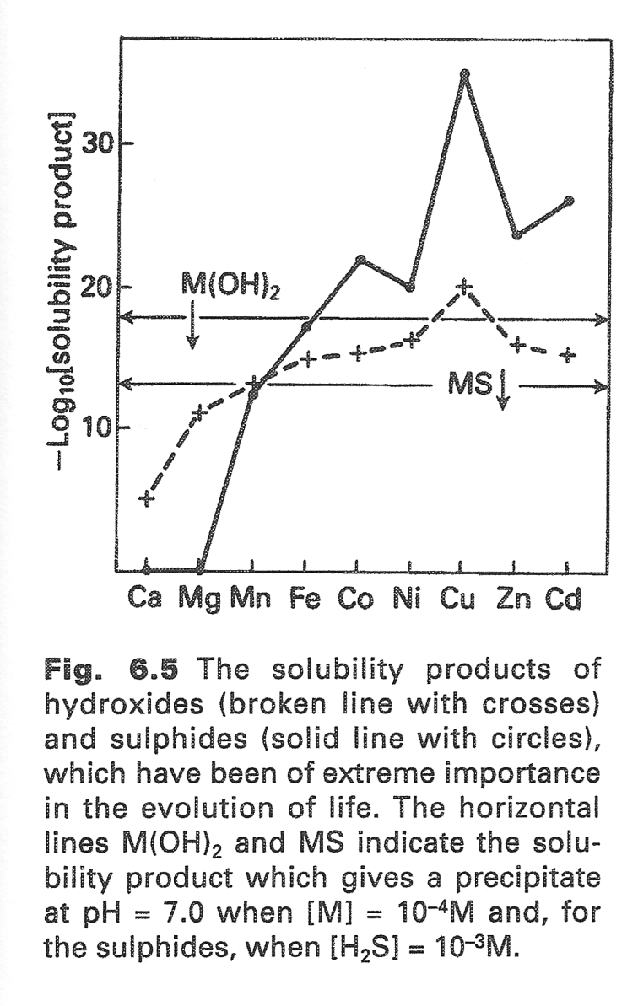
Different metals dissolve differently in oxygen-rich vs. sulfur-rich oceans
Compare the K_{SP} of the sulfide to the oxide
In ocean after acid was titrated out and H₂S dissolved, Co, Cu, and Zn precipitated out.
Mn, Mg, and Ca were present at the time but would precipitate more when oxygen increased.
Fe and Ni are very similar and “in the middle”: should be around sparingly both in S-rich and O-rich times

Slide 16
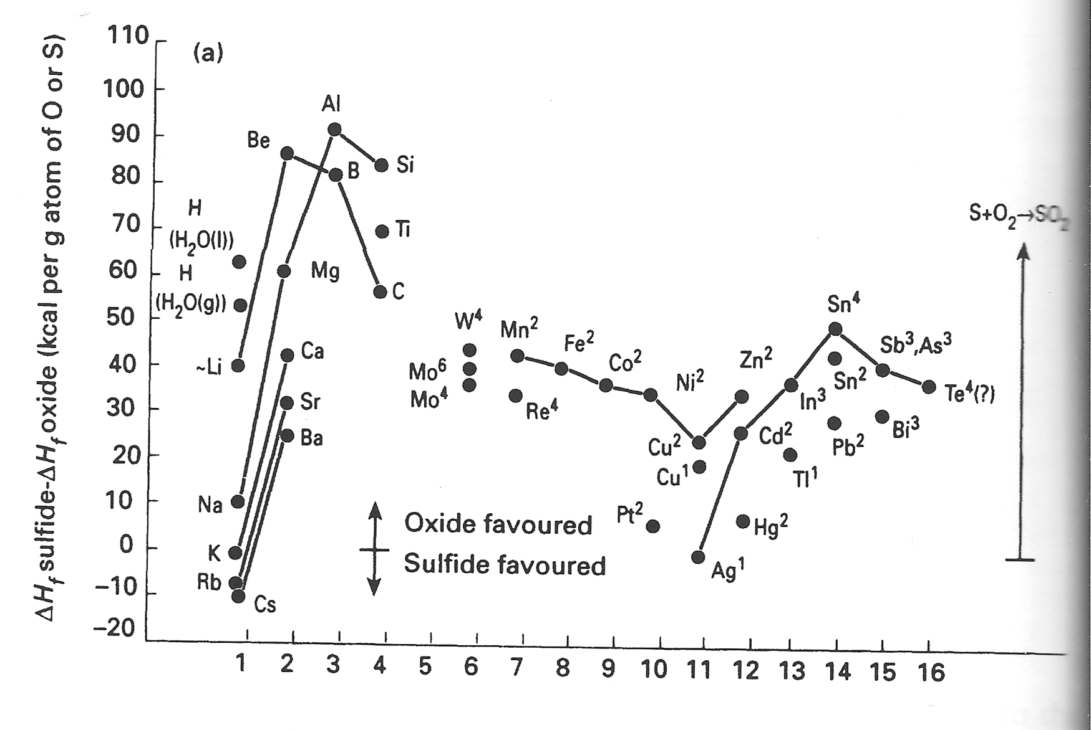
ΔH_{f} of sulfides vs. oxides gives a similar conclusion

Slide 17
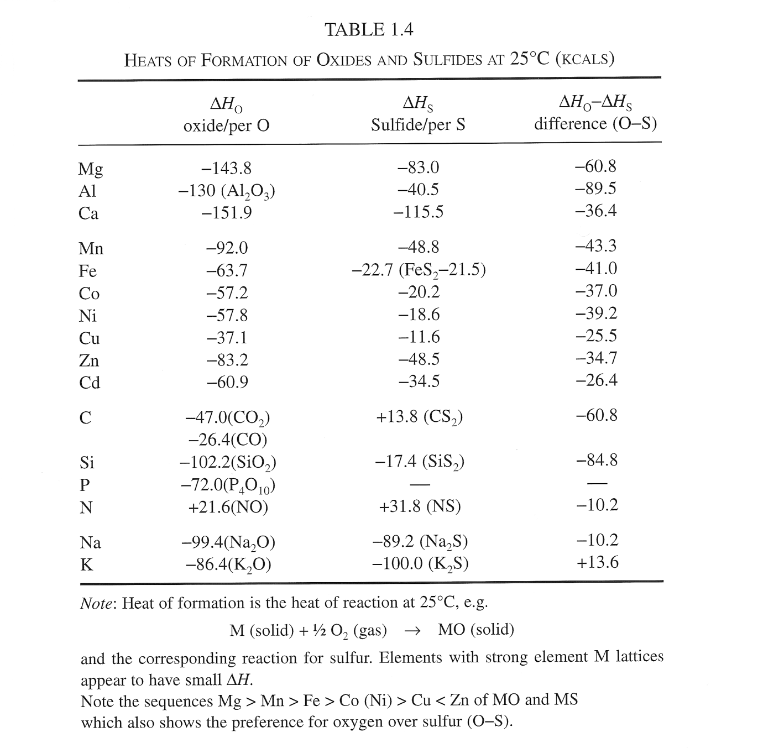
Other metals hogged all the O, and Fe was left as FeS or other alloys

Slide 18
Why does burning anything always release energy? (Or, why is fire hot?)

Slide 20
TYPO!!!

Slide 21
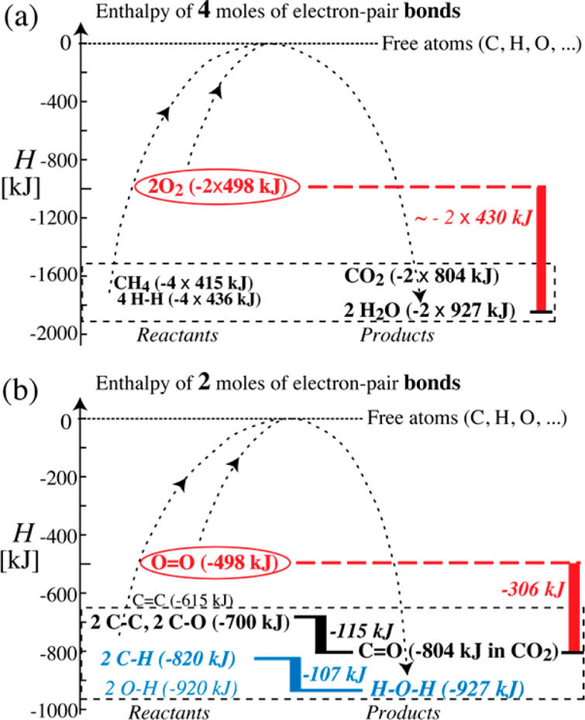

Slide 22
Combustion of a general C, H, O-containing molecule
Losing bonds to carbon
Gaining bonds to oxygen, which is proportional to amount of O2 in rxn

Slide 23
Don’t forget heat of condensation of H2O

Slide 24
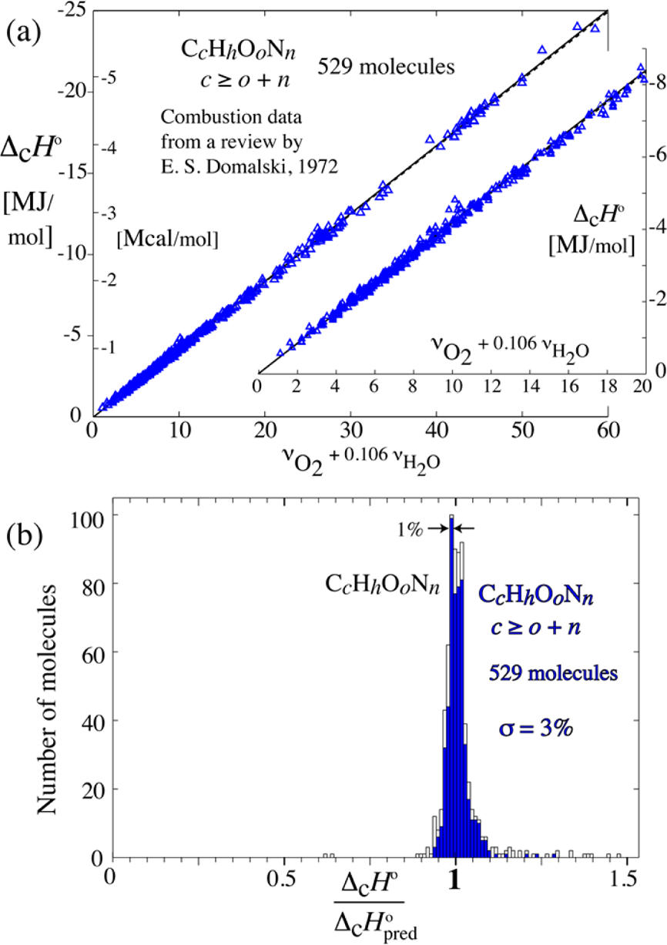
All combustions give more enthalpy if they involve more oxygen

Slide 26
Bring 2 questions on Wednesday (written)
Preferably one for discussion (no answer necessary), and one for homework (with answer)
  Involving the topics from Chapters 4-6 of AWfD
  Possibly using data or concepts from today?
We will discuss what you wrote in the first half-hour of class
  (And if I like a HW question I may write it into the test!)

Slide 27
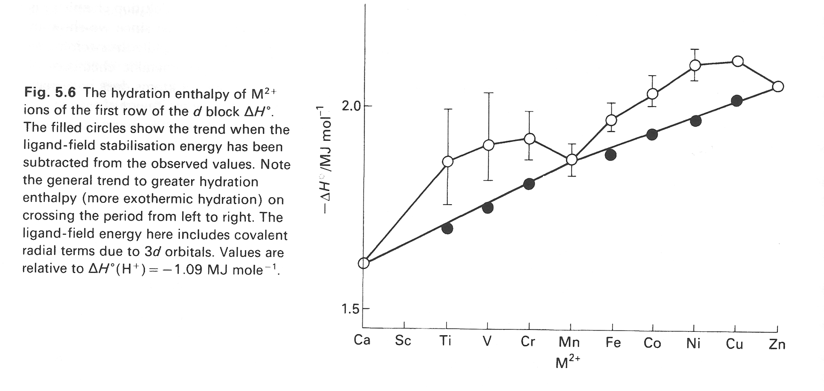
Notice that metals on the right side of the periodic table have greater hydration enthalpies
Because of these enthalpies, these elements are more stable in water and more useful for life
The other elements were left out of the metallome
Ca must be special somehow …

Slide 28
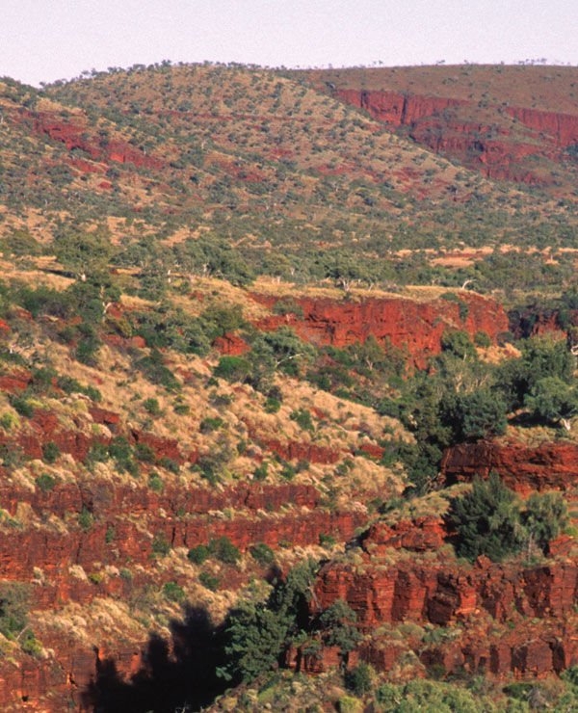
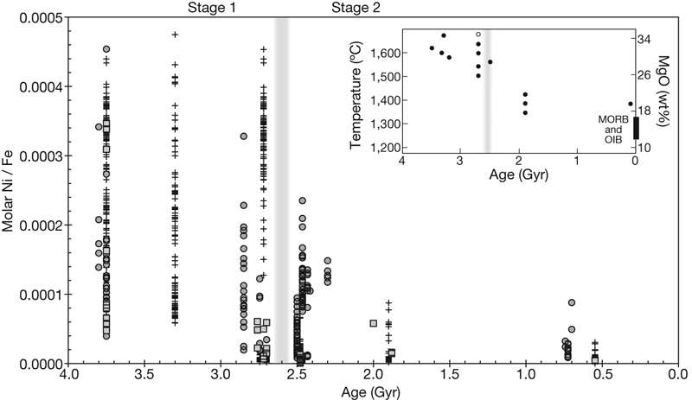
Geochemists looked at Fe and Ni in banded iron rocks in Australia
They found that the Ni/Fe ratio dropped off a cliff 2.7 billion years ago, just as the lava temperature cooled past 1500ºC
http://www.nature.com/nature/journal/v458/n7239/fig_tab/458714a_F1.html

Slide 29
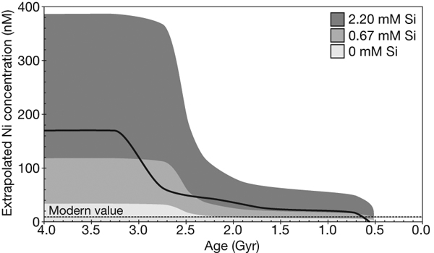
A modest proposal: The lava got too cool to carry Ni
So the methanogens ran out of Ni and had to retreat to Ni-rich areas starting 2.7 billion years ago.
  They had no choice: Ni kinetics are slow and its loss can’t be fixed with greater uptake
Then, 2.4 billion years ago, the Great Oxidation Event happened.
Guess the (lack of) Ni was the chicken and the O₂ was the egg!
Black line: [Ni] in ocean vs. age
http://www.nature.com/nature/journal/v458/n7239/

