Slide 1
Oxygen Changes Everything
Data Talk for Chapters 7-9 of A World from Dust

Slide 2
Two parts
How different metals catalyze different reactions
  Fe in rock makes H2
  Fe/Ni in enzymes makes H2
  Mn makes O2
How oxygen changed which metals were available – resulting in different reactions

Slide 5
From the energies, which of these works best?

Slide 6
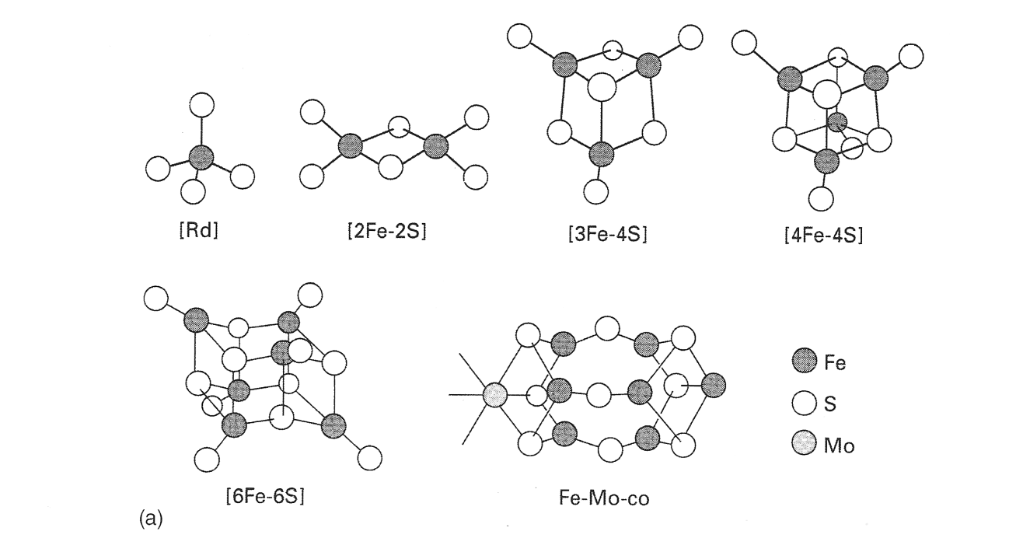
Because Fe is a special ion, it forms special structures
Because Fe can potentially flip between the +2 and +3 states, it can form unique structures with electron-rich ligands like sulfur:
  Iron-sulfur clusters, and it is stored as hydroxide in ferritin (and Fe+O makes magnets!)
  These Fe-S clusters are the major soluble form of iron in sulfur-rich seawater …

Slide 7

So did Fe-S enzymes form when a protein grabbed a Fe-S cluster?
This is the active part of an early hydrogenase enzyme
  Notice the unusual cyanide and CO there, just like we’d expect to find on the early earth!

Slide 8
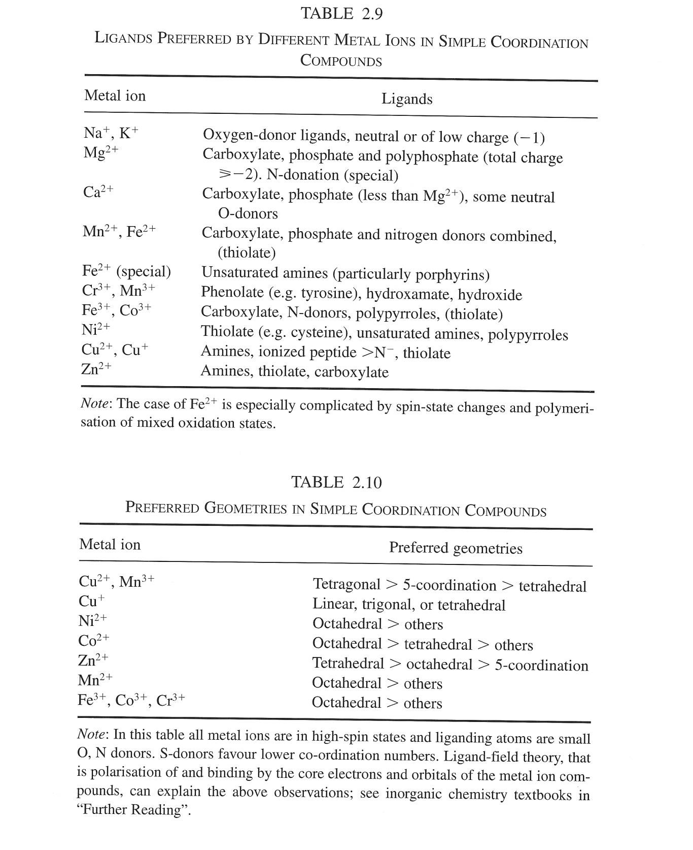
Each metal has a binding “personality”
This is inorganic chemistry

Slide 9

So use the personality of each metal to pick it out of a lineup
http://psyc.queensu.ca/~mansourj/images/lineup-big.jpg

Slide 10
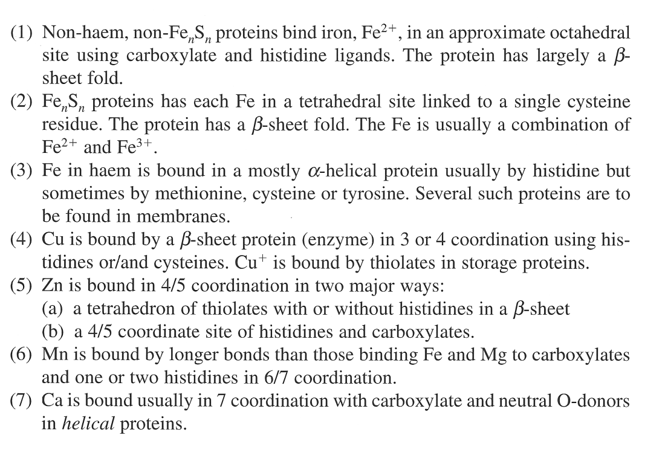
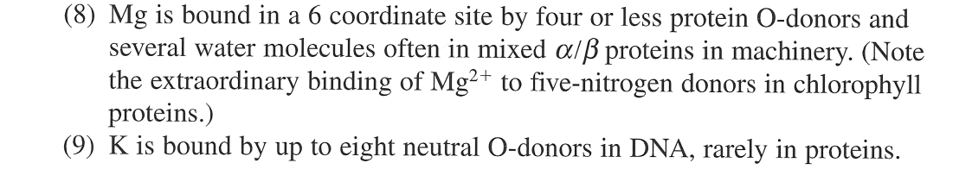
The “personalities” imply that only a few simple rules are needed to pick one out of a lineup (or a cytoplasm)
This is simple because only about 10 metals are even available in the cytoplasm
  (And Na and K don’t bind ANYTHING strongly!)
I see protein design projects here!

Slide 11
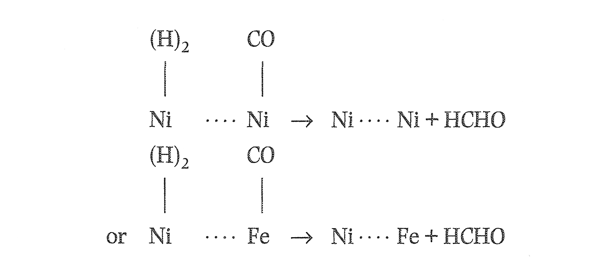
It’s pretty easy to make a carbon-reducing enzyme from Ni and Fe
Ni binds H₂, Fe binds CO, bring them close and voila! … C-H bonds.

Slide 12
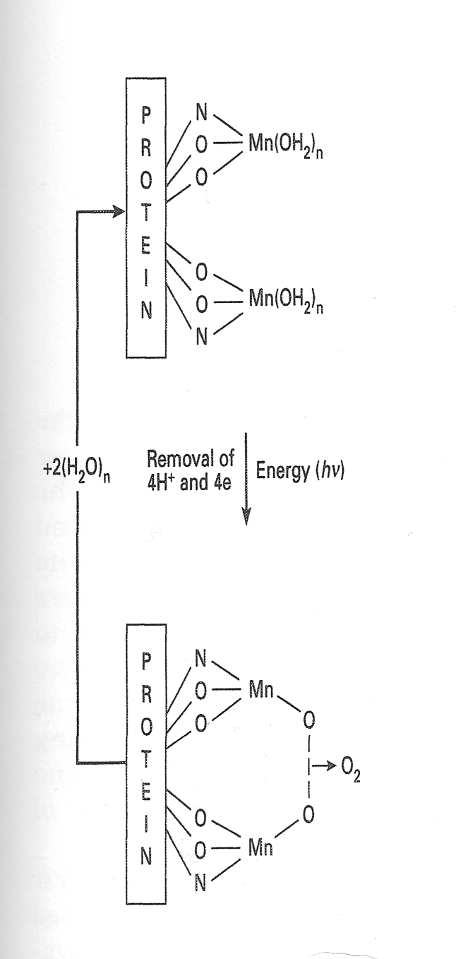
Mn is special: What Fe can do for CO, Mn can do for oxygen!
Mn does not bind sulfide (and therefore the protein must bind it with N and O)
It can hold H₂O close until energy from light/photons knocks off the protons and oxidizes it to O, which will combine with another nearby O to make oxygen
It’s true, H₂O is very stable, but this can happen because there’s SO much H₂O around, plus there’s SO much energy in sunlight

Slide 13
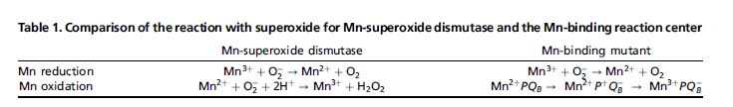
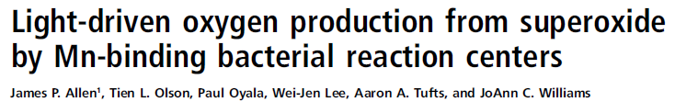
Could this actually happen in the lab? It (kind of) has:
JoAnne Williams Lab (ASU) has engineered a bacterial photosystem that didn’t bind Mn to bind Mn
  By adding Asp, Glu and His (Mn’s “favorites”)
  Surprisingly easily!
Suddenly it can do LIGHT-driven oxygen chemistry:

Slide 15
It’s easy to make, too

Slide 17
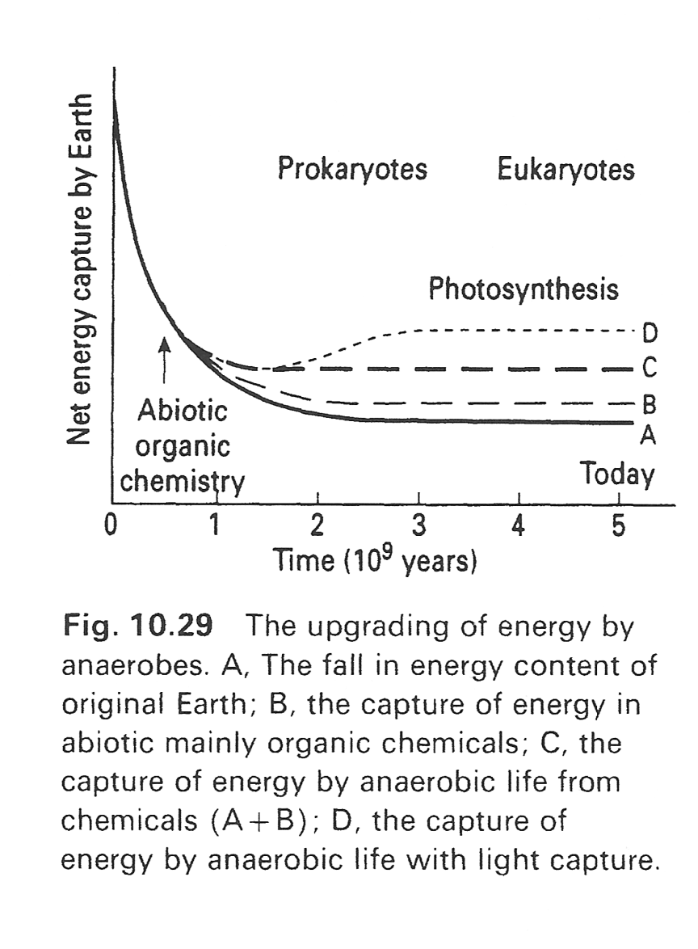
Because of Mn, energy from heaven was stored on earth
Photosynthesis is using the sun’s energy to form new chemical bonds on earth
So plants have actually increased the net energy capture of our entire PLANET
  Starting around the time of the GOE
(We can benefit from this when we eat them)

Slide 18
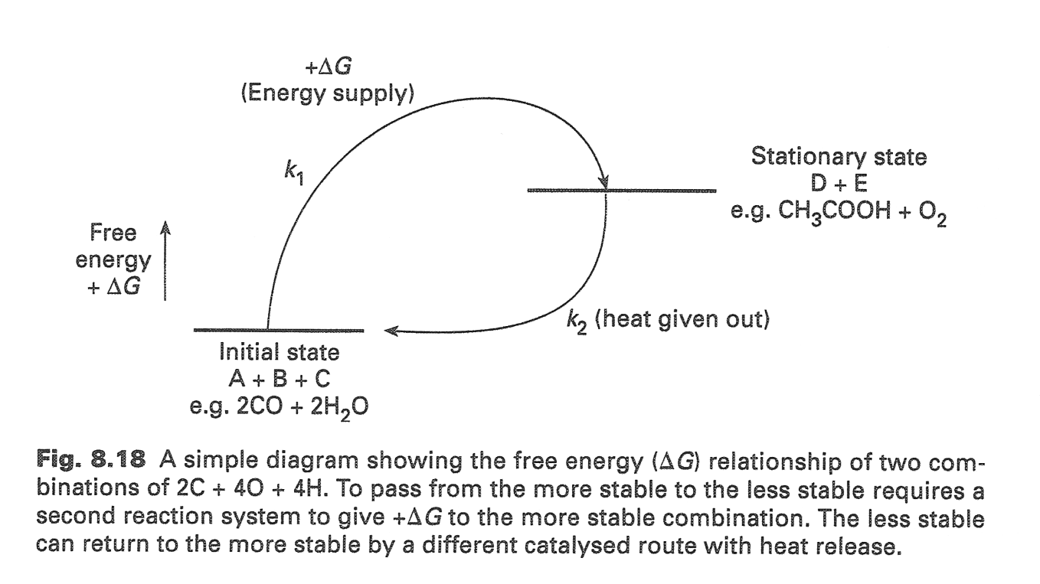
Sunlight gets turned into a complex carbon structure, which is later burned to produce heat
High-E light comes in
Dispersed energy goes out

Slide 19
Oxygen in the atmosphere increased over time

Slide 20
Over time, O-bound things increased, H-bound things decreased, and the charges on metal ions increased

Slide 21
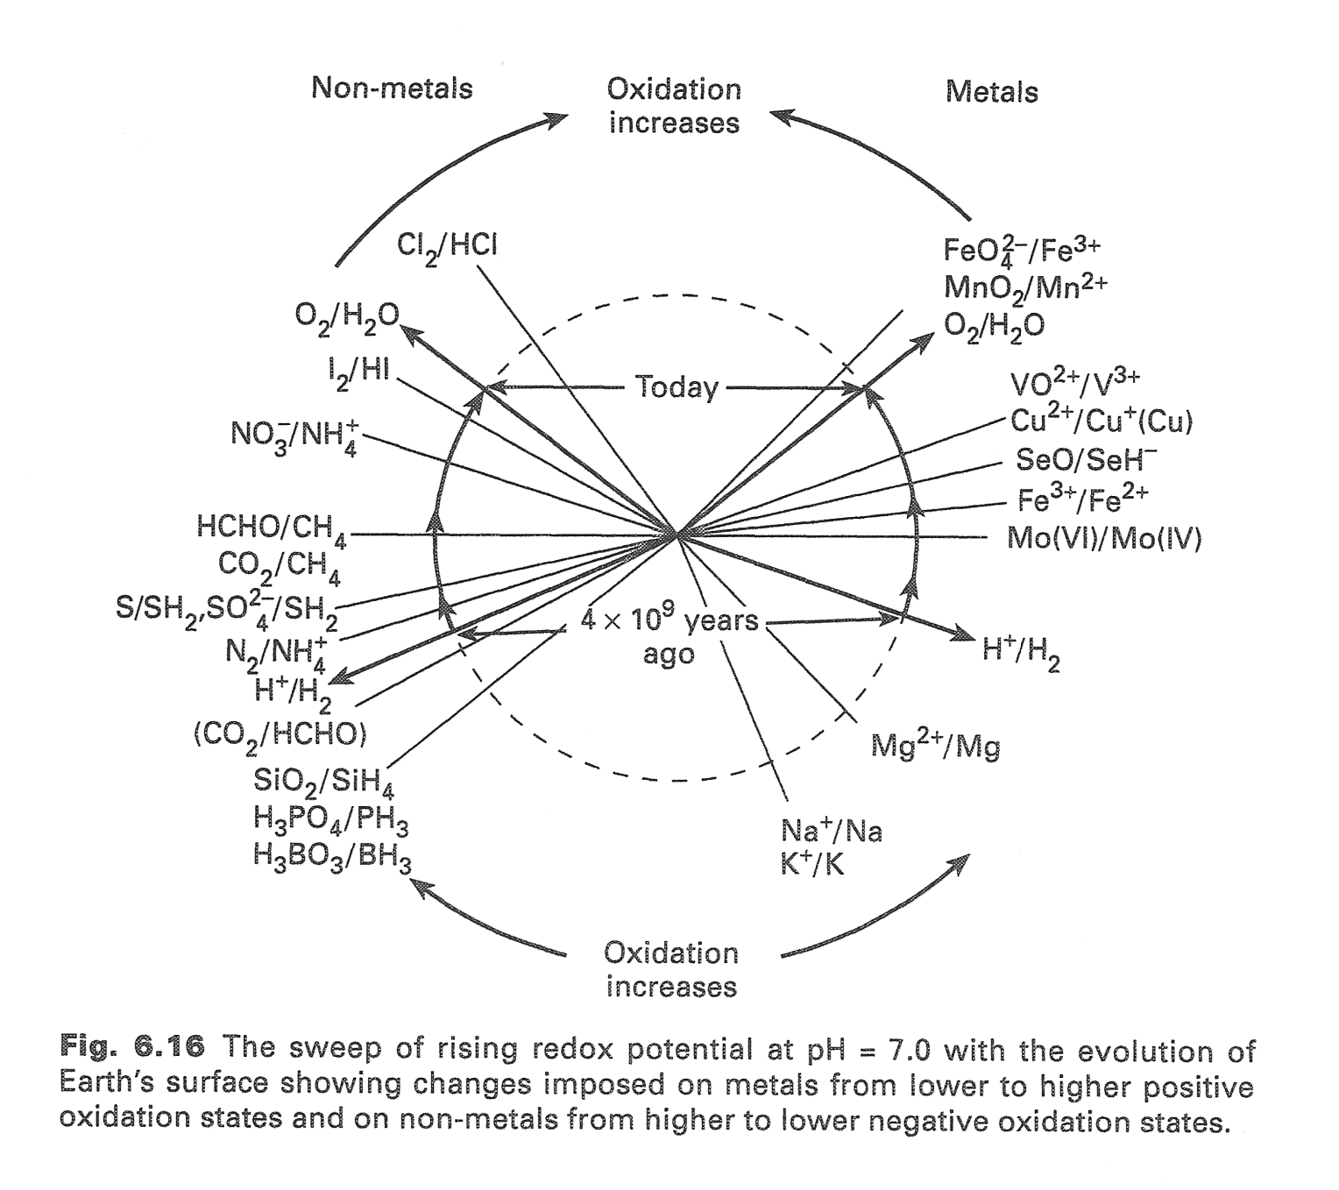
RJP Williams arranged redox reactions in a wheel.
Nitrate/N₂ instead of ammonium
Iron(II) became more rare
Sulfate instead of sulfide
Iron (III) hydroxide
Is VERY insoluble
CO₂ instead of CH₄ or CO

Slide 22
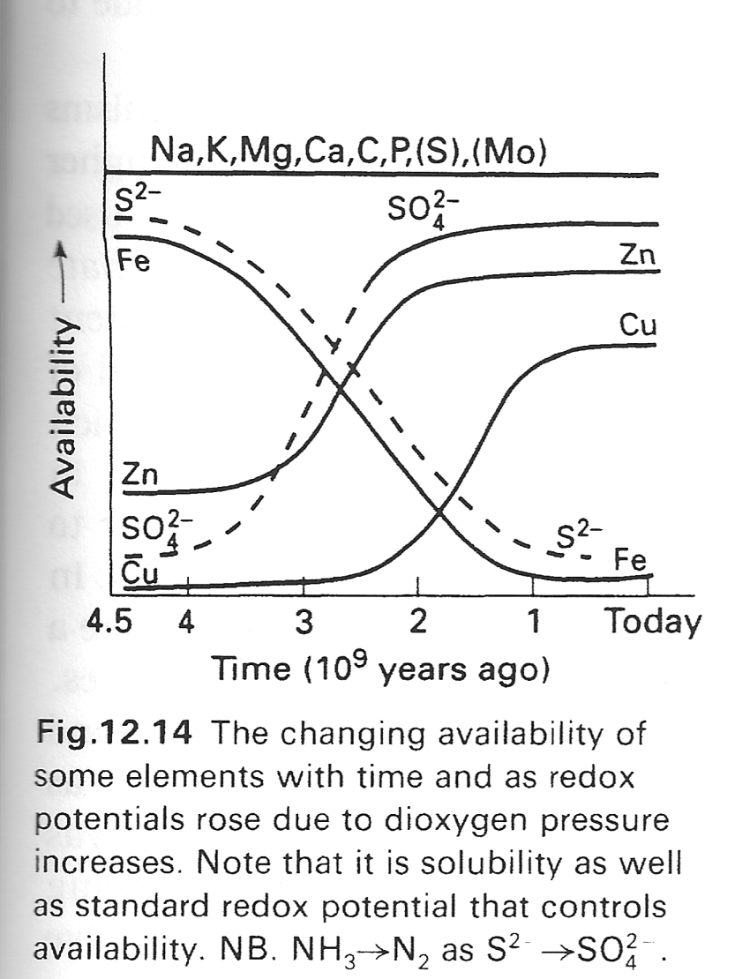
The timing of the return of elements
First sulfate and Zn return
Then Fe goes away (well, becomes a trace element in the ocean)
  (Co goes away too)
Then Cu returns

Slide 23
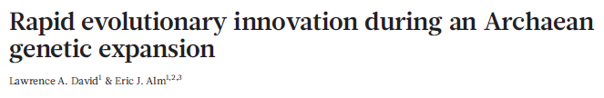
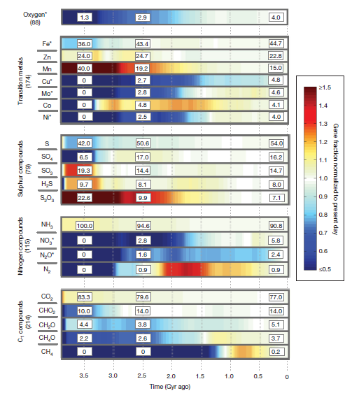
Biochemical computational evidence of when proteins used different metals roughly matches RJPW’s hypothesis

Slide 24
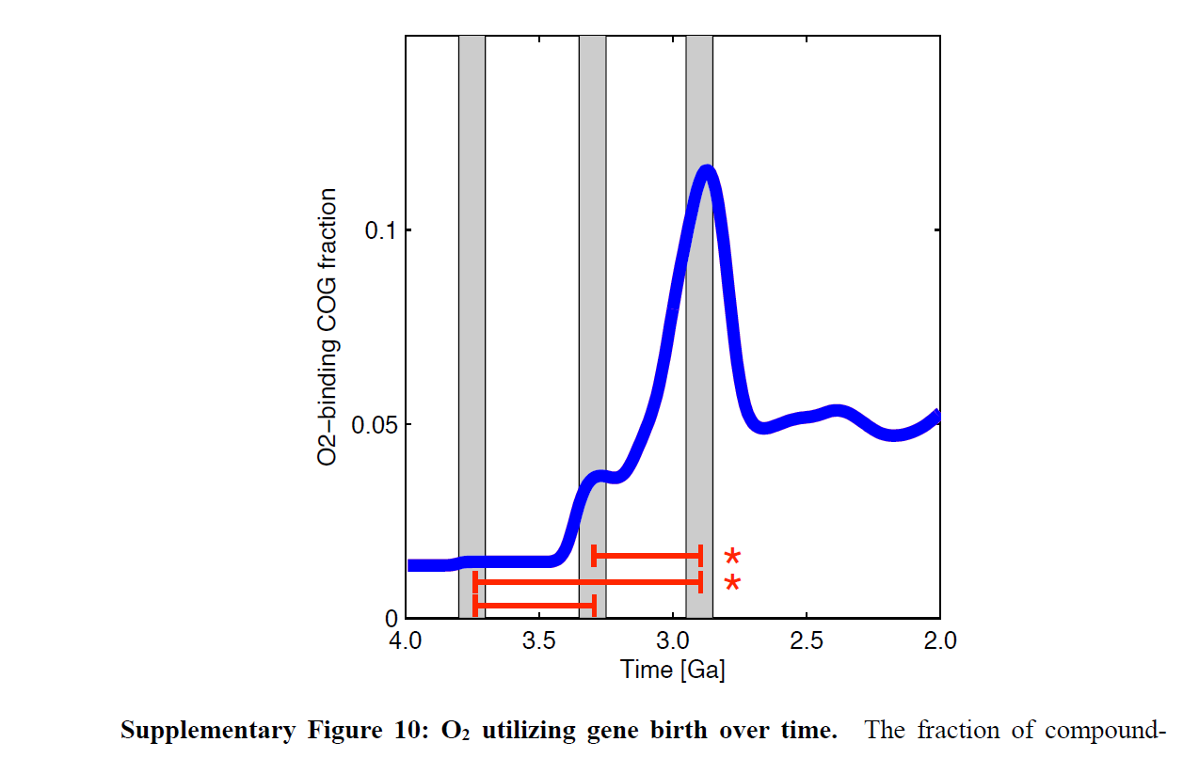
~10% of all oxygen-using genes were “born” in a quick burst 2.9 billion years ago

Slide 25
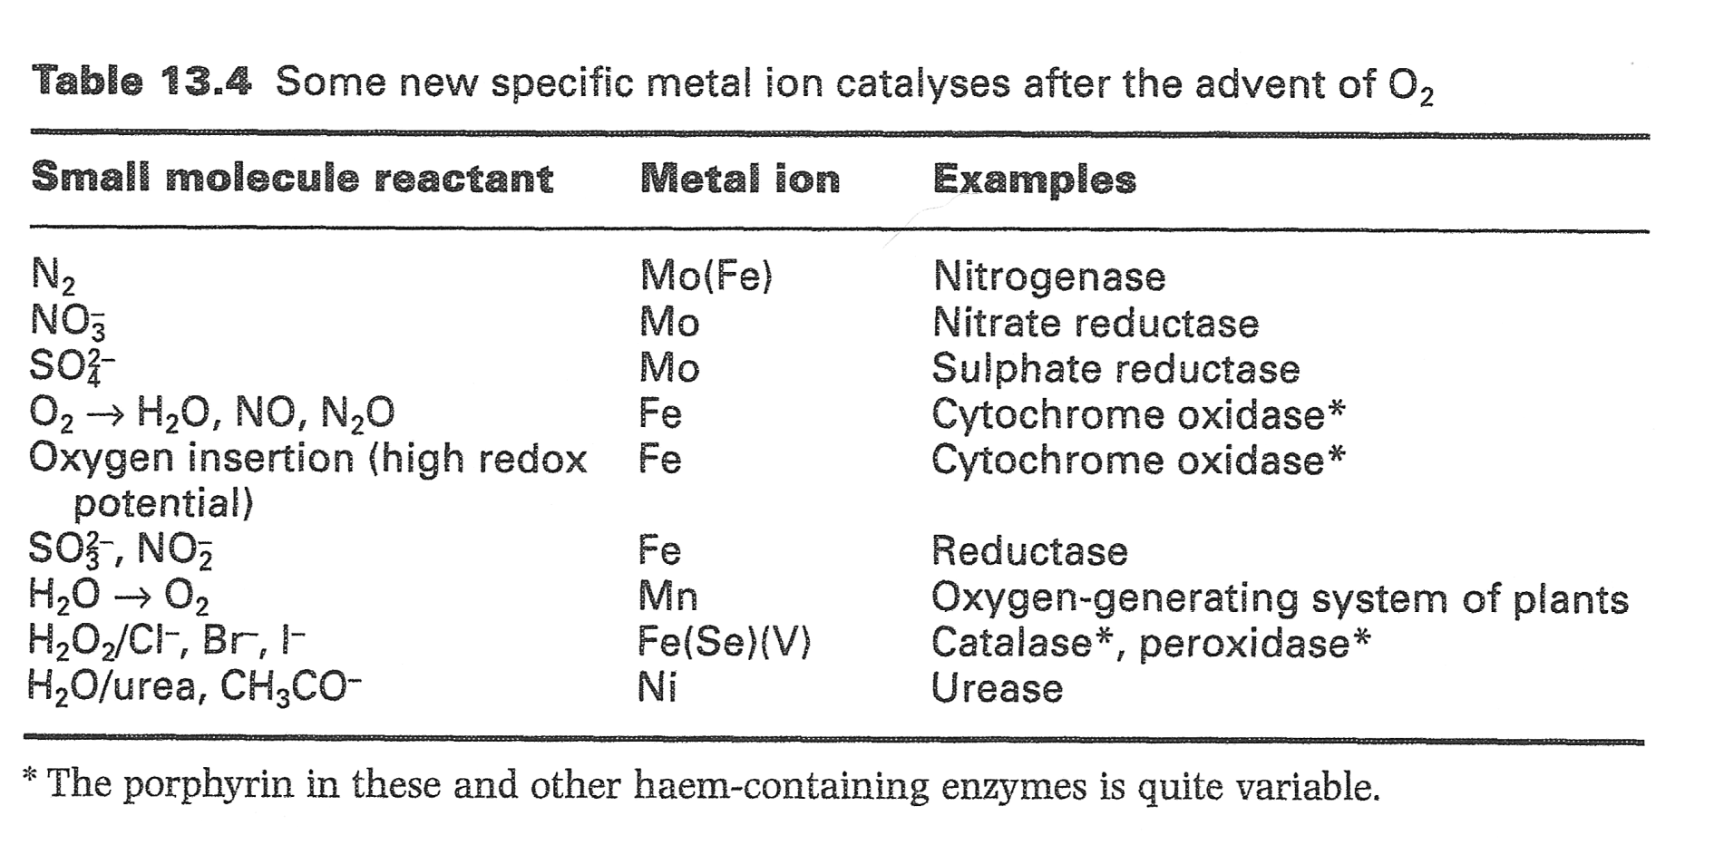
After oxygen, enzymes could do new things
Mo did not change its solubility but did change its oxidation state, similar enough! It is used in humans in two enzymes that detoxify oxygen-containing things: sulfite and ethanol

Slide 26
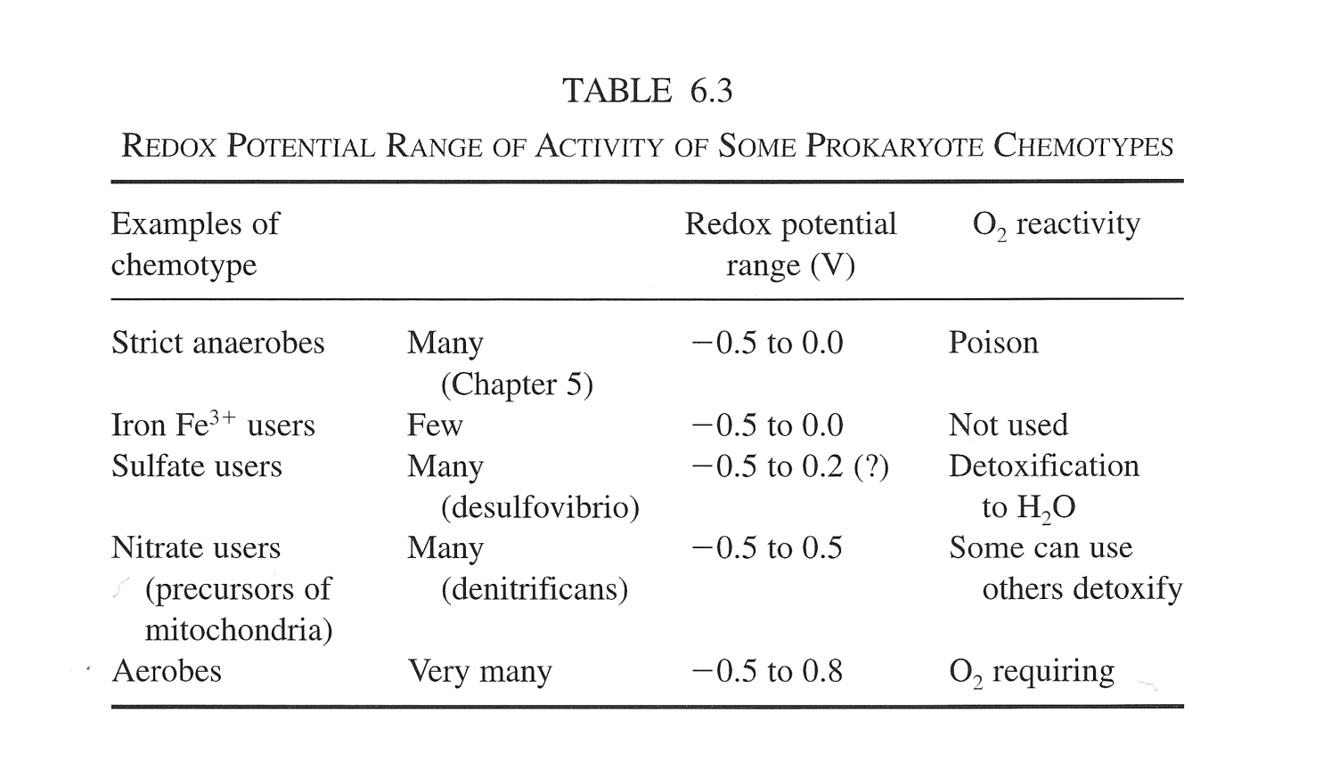
As oxygen increases, the redox potential of the organism also increases
Is using an electrode to measure potential one way to date an organism’s time of origin?
Notice a trend?

Slide 27
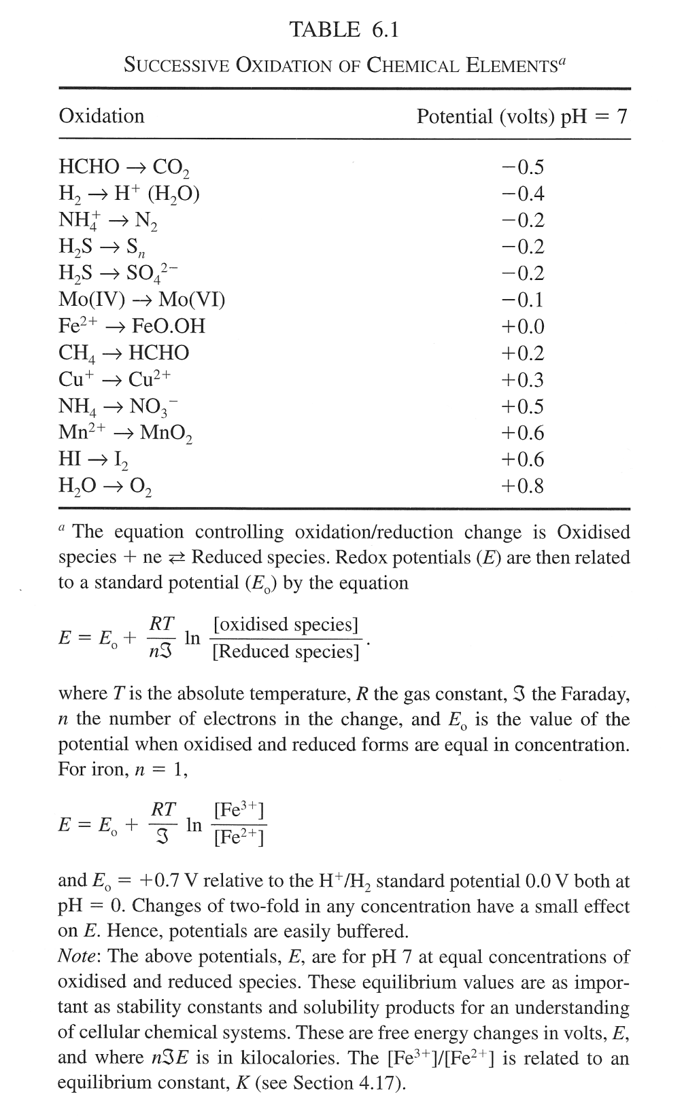
As oxygen increases in the atmosphere:
Notice how the sequence of availability goes with E as well as K_{sp}
The redox potential of the earth expands from a -0.5 to 0.0 range up to +0.8

Slide 28
Due on Monday
Please write 2 questions for discussion, as before

